Slide 1
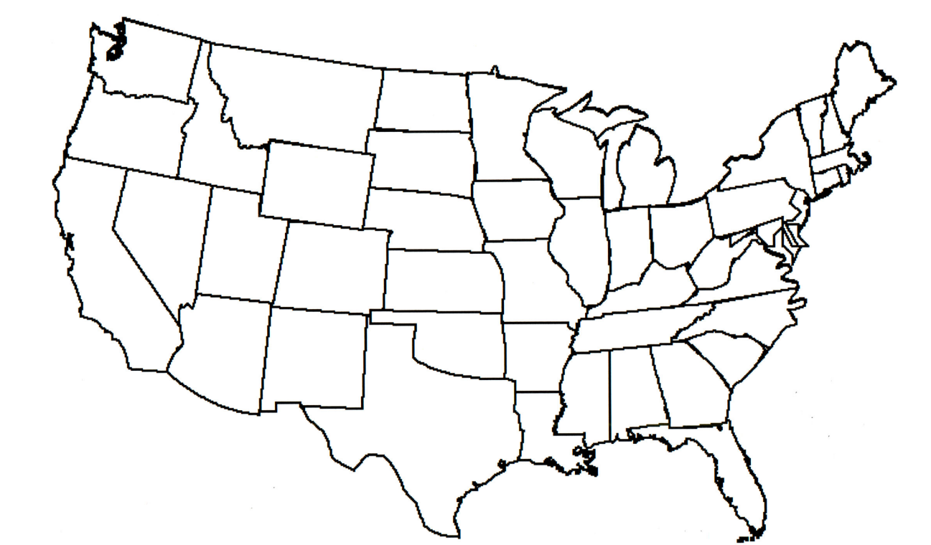

Where are Cattle Grown?

