Slide 1
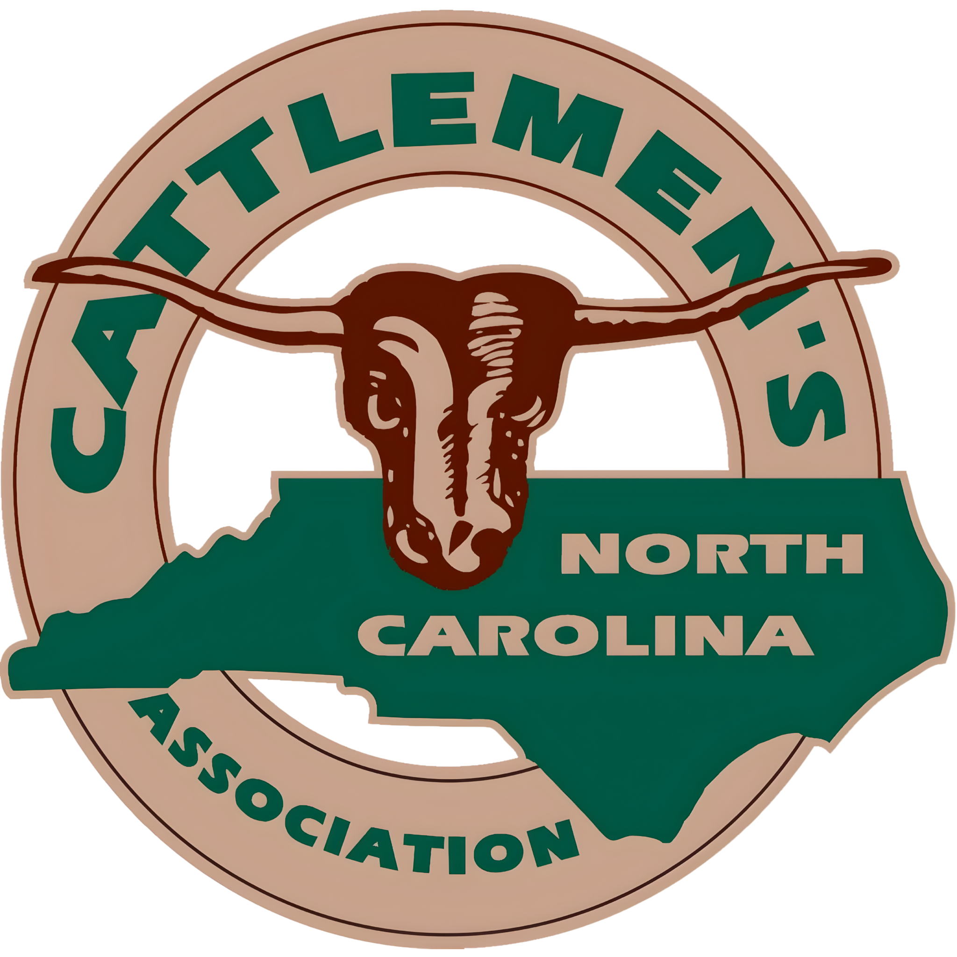
Instructions
Print and cut out station signs for parts of the ruminant stomach
Place them around the room
Print page 2
Print page 3

Slide 2
Rumen | Omasum
Reticulum | Abomasum

Slide 3
The Giant Blender What happens here: This is the biggest compartment! It's full of helpful little microbes that break down tough grass. | The Book Pages What happens here: This compartment has lots of layers that look like pages in a book. Its main job is to squeeze all the water out of the food. | The True Stomach What happens here: This is just like a human stomach! It uses strong acids and juices to finally digest the food completely so the animal can get energy.
The Honeycomb & Safety Net What happens here: This compartment looks like a honeycomb. It helps push food back up to the mouth, and it acts as a magnet to catch things the animal shouldn't have swallowed (like wires or nails!). | Food enters What happens here: Food drops into these two first. | Fermentation What happens here: Good bacteria breaking down the grass like a compost pile.
Regurgitation / Chewing Cud/ Filters What happens here: Pushes the food back up to the mouth to be chewed again. The honeycomb wall traps hardware/trash. | True Digestion / Acids What happens here: Uses acid to break down food, just like our stomachs. | Water Absorption What happens here: Squeezes out the moisture like a sponge.

Slide 4
The Order
Mouth (Eat)
Rumen/Reticulum (Ferment)
Back to Mouth (Chew Cud)
Omasum (Squeeze Water)
Abomasum (Acid Digestion)

