Slide 1
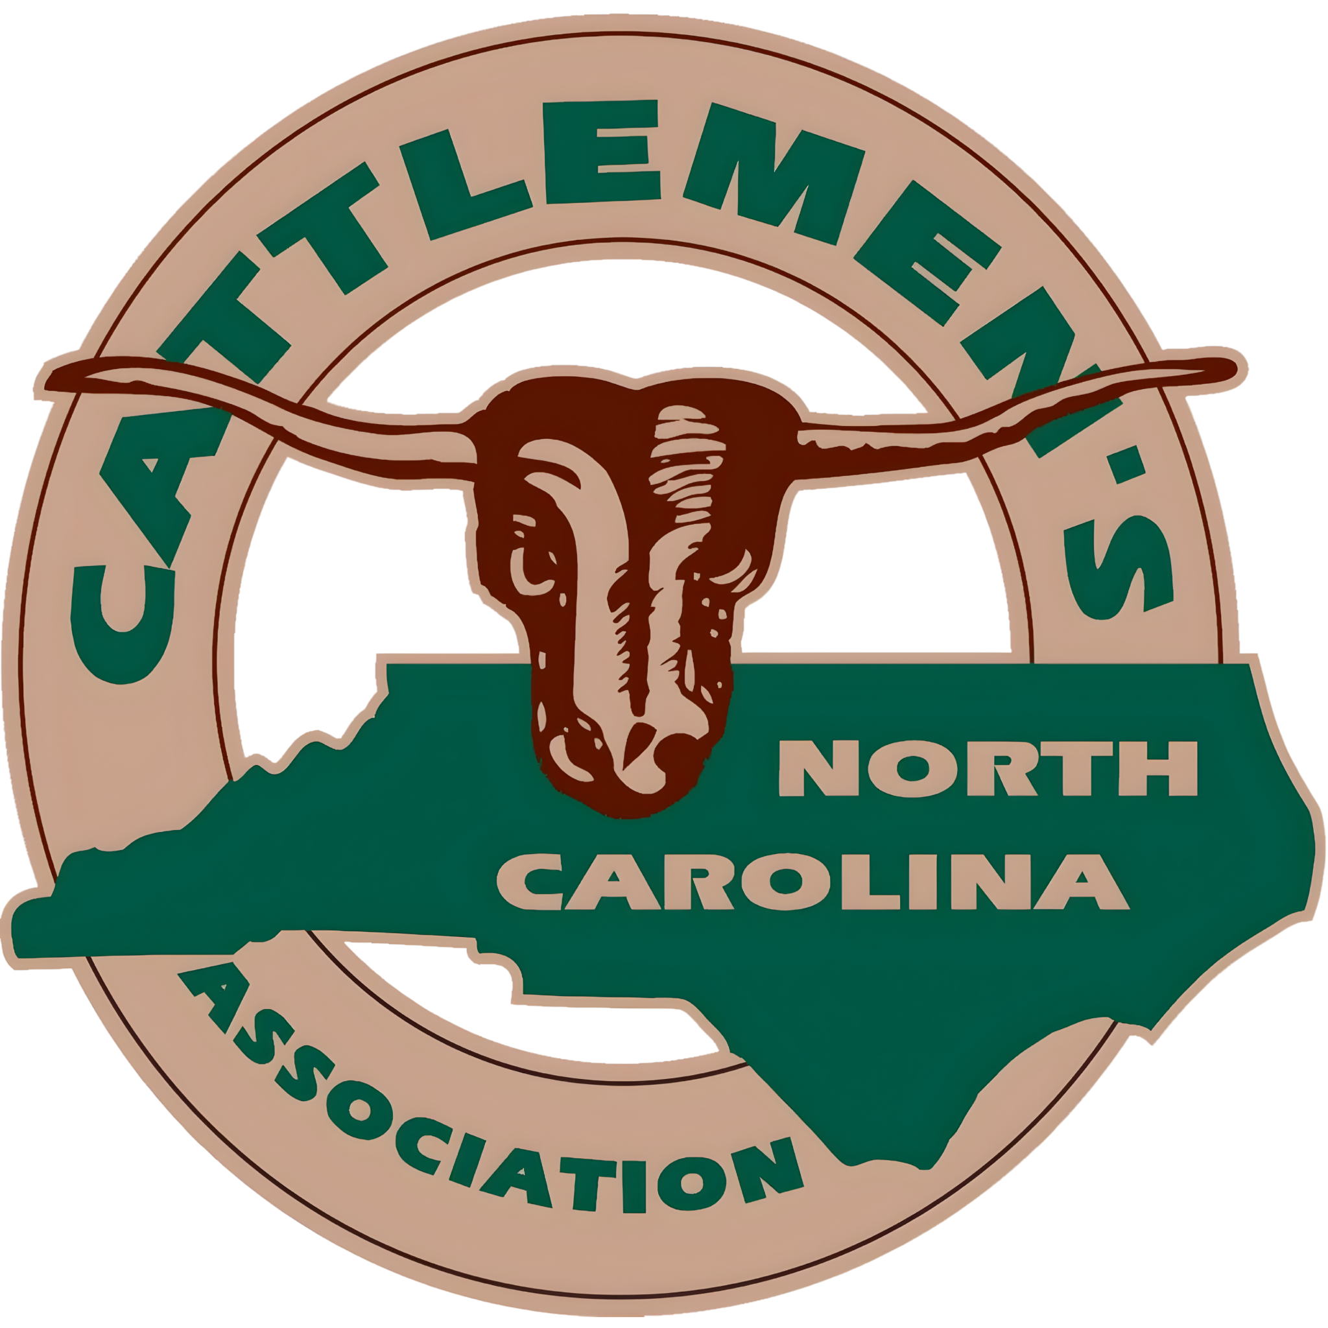
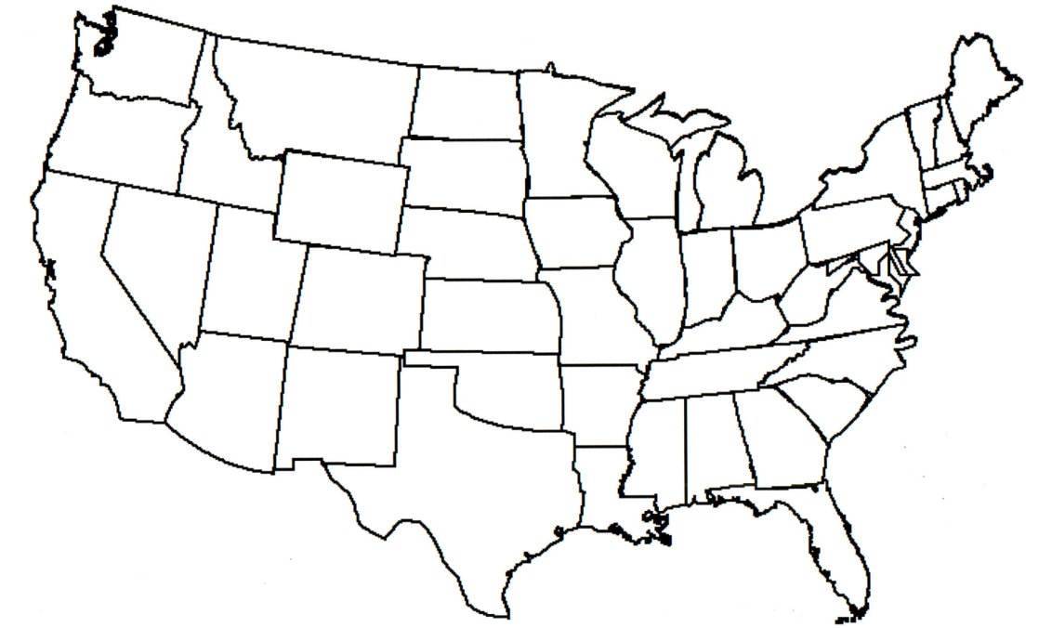

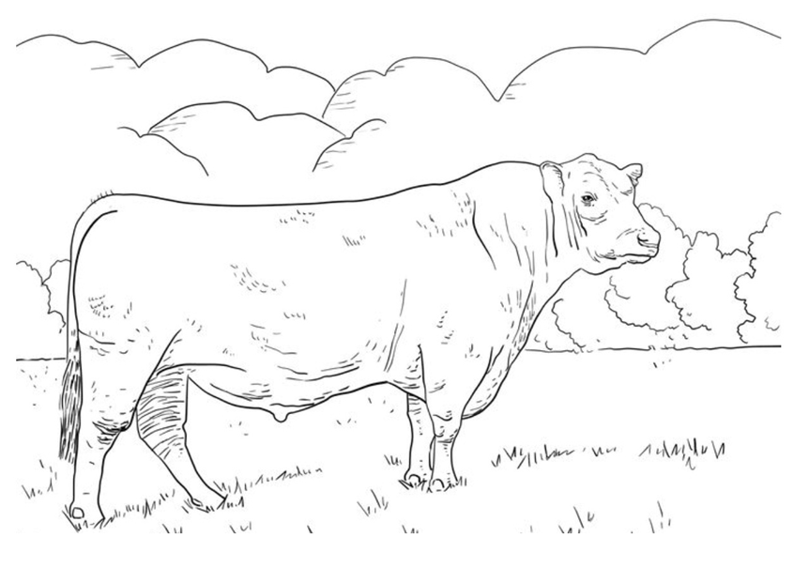
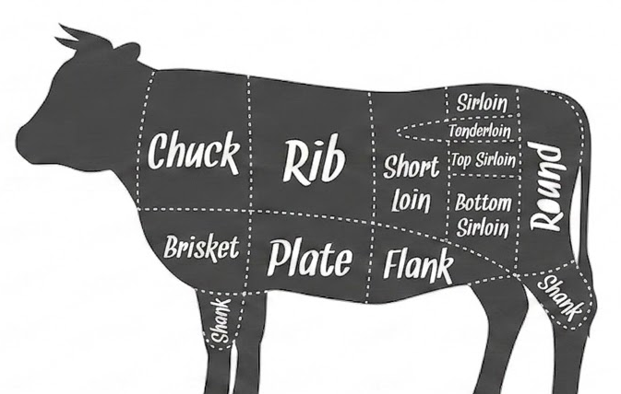
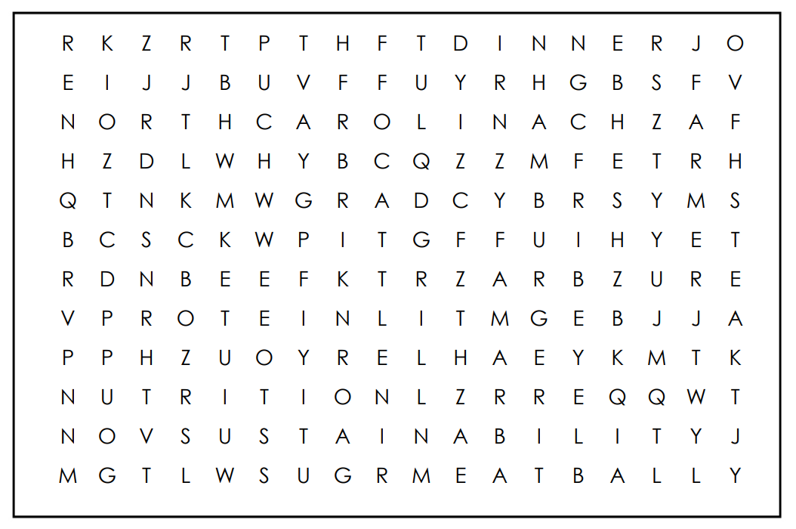
Cuts of Beef Scramble
Unscramble the words: shank, sirloin, round, loin, chuck, flank, tenderloin, brisket
Label each state that grows cattle in the U.S.
NKASH
KISBRET
OURDN
NALFK
OIRNLIS
CUKHC
REOILTNDEN
OILN
QR code placeholder for lesson plans and activities
Word List
Find the Words:
BEEF
CATTLE
DINNER
FARMER
GRILL
HAMBURGER
NORTH CAROLINA
MEATBALL
NUTRITION
PROTEIN
RIBEYE
STEAK
SUSTAINABILITY

Slide 2
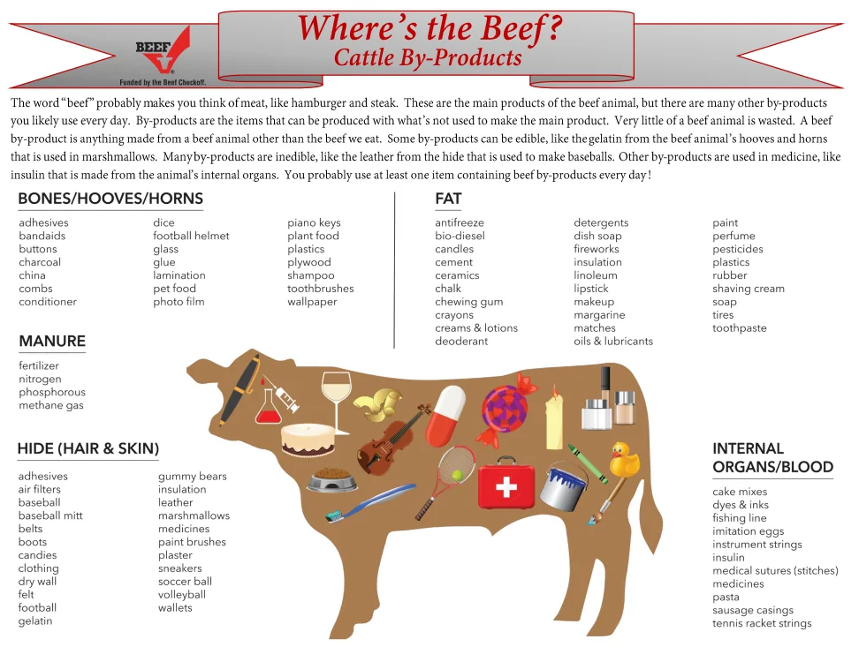
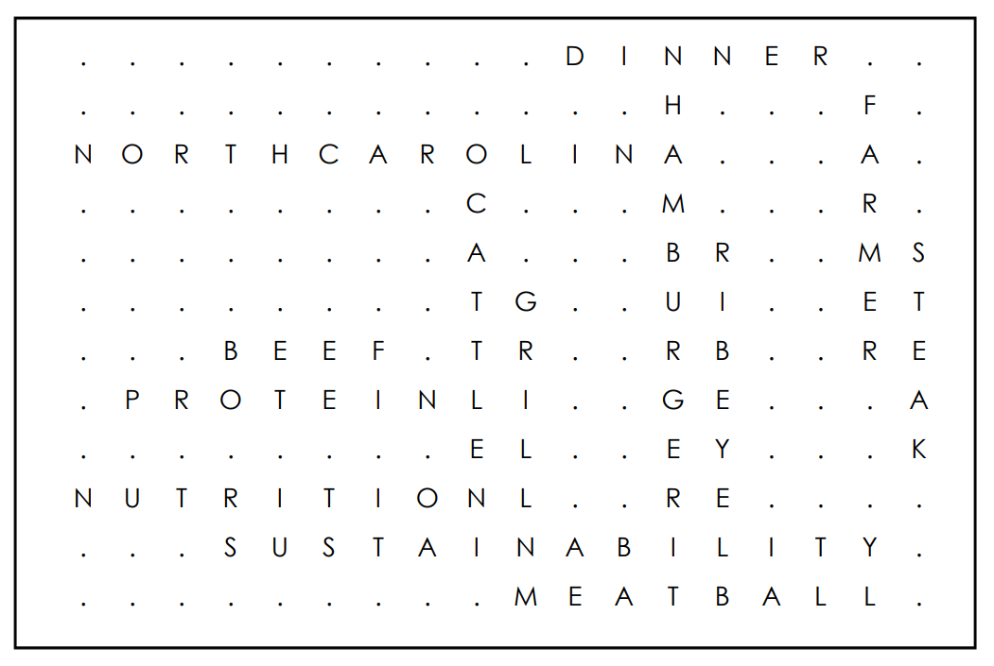

Visit https://www.nccattle.com/ to gain access to NC Cattlemen’s Association beef curriculum.
The Power of Beef
Farmers raise beef cattle because beef is a delicious and healthy choice that helps your body grow. You can remember how beef helps you by using the word ZIP:
Z (Zinc): Helps you maintain a healthy immune system so you don't get sick.
I (Iron): Helps your body carry and use oxygen.
P (Protein): Helps you build and keep strong muscles for playing and growing.
A huge thanks to NC Cattlemen’s Association and the North Carolina Tobacco Trust Fund Commission for funding this beef project.
NKASH | SHANK
KISBRET | BRISKET
OURDN | ROUND
NALFK | FLANK
OIRNLIS | SIRLOIN
CUKHC | CHUCK
REOILTNDEN | TENDERLOIN
OILN | LOIN
Answer Key

