Slide 1
North Carolina Cattle Conference
February 21, 2025
Mike Murphy

Slide 2
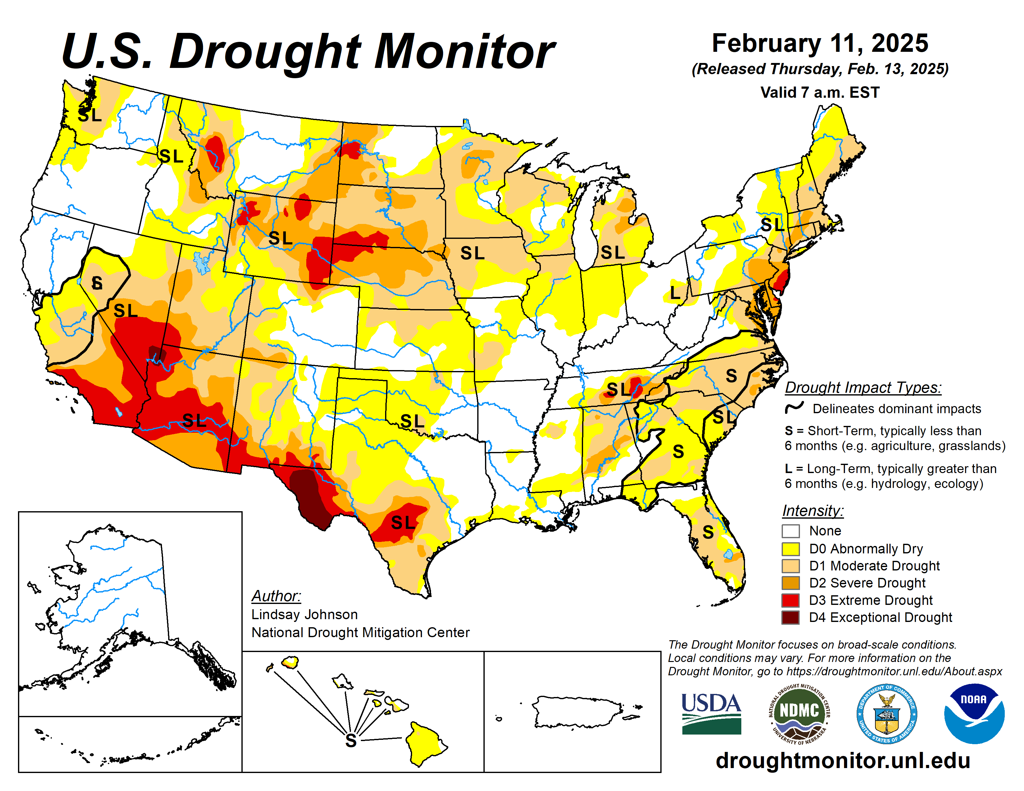

Slide 3
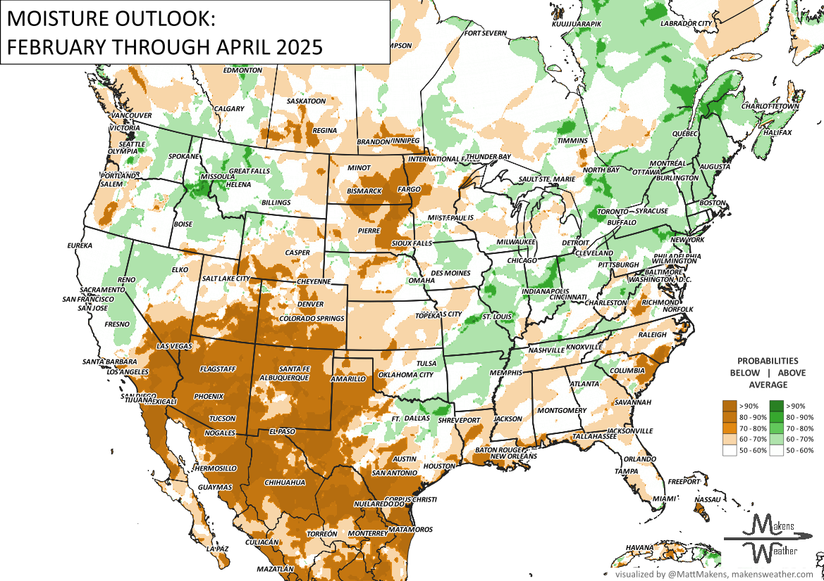
THE ODDS FAVOR
THIS LOOKS VERY LA NIÑA. THE DRIEST IS THE SOUTHWEST AND PORTIONS OF THE PLAINS.

Slide 4
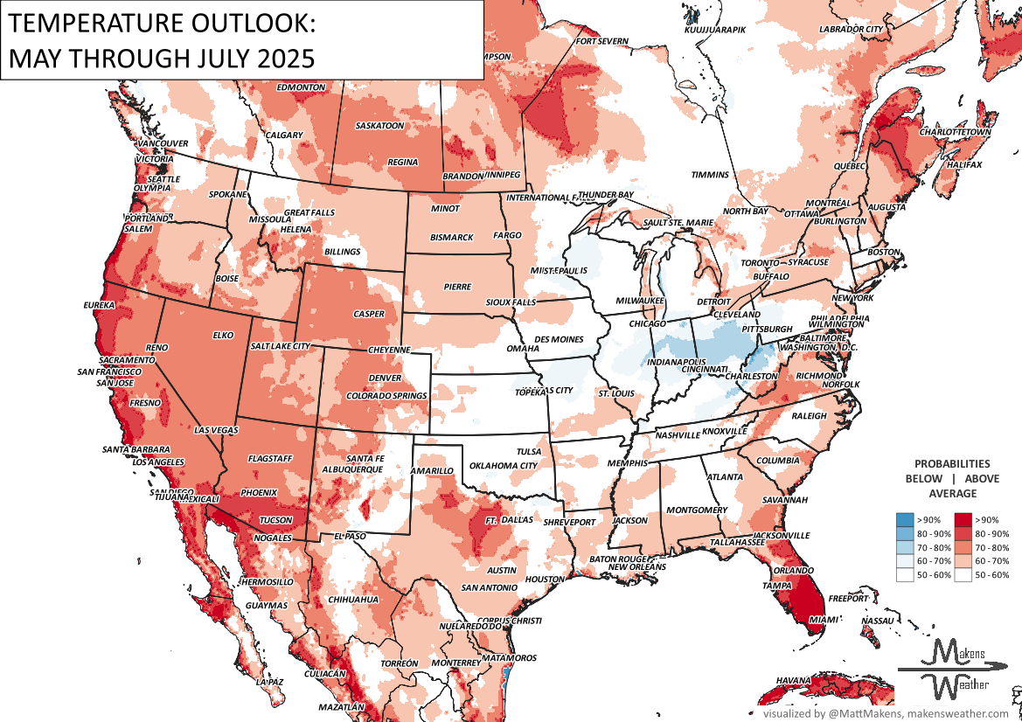
THE ODDS FAVOR
FACTOR IN MODELINGS’ WARM BIAS…COOLER POCKETS OF WEATHER FOR THE CENTRAL U.S./MIDWEST. HEAT BUILDS ACROSS THE WEST AND PARTS OF CANADA.

Slide 5
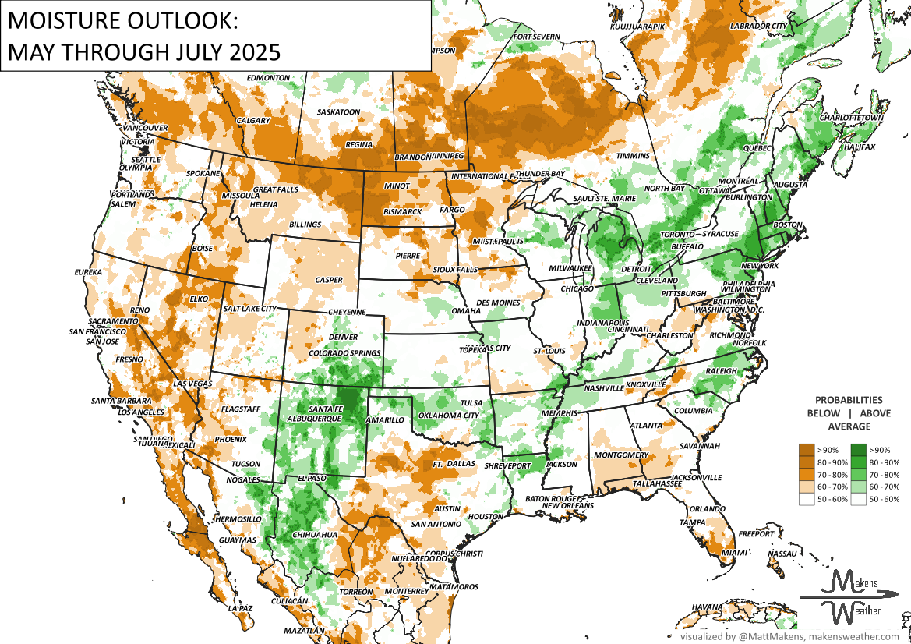
THE ODDS FAVOR
HISTORY SUPPORTS A STRONGER MONSOON SEASON THAN LAST YEAR’S. MOISTURE FOR THE CORN AND NORTHERN HAY HIGHLY TIMING DEPENDENT.

Slide 6
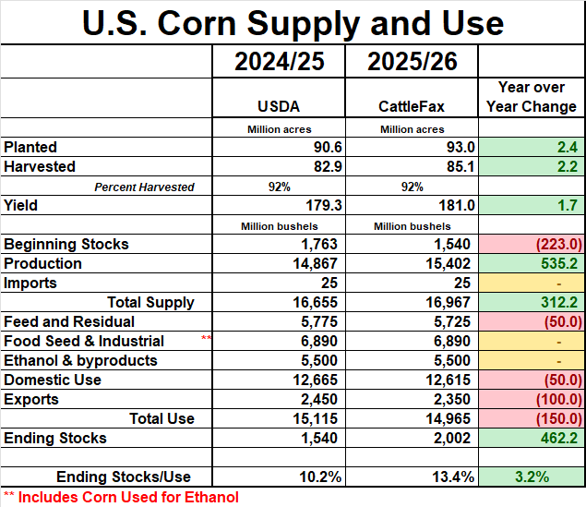

Slide 7
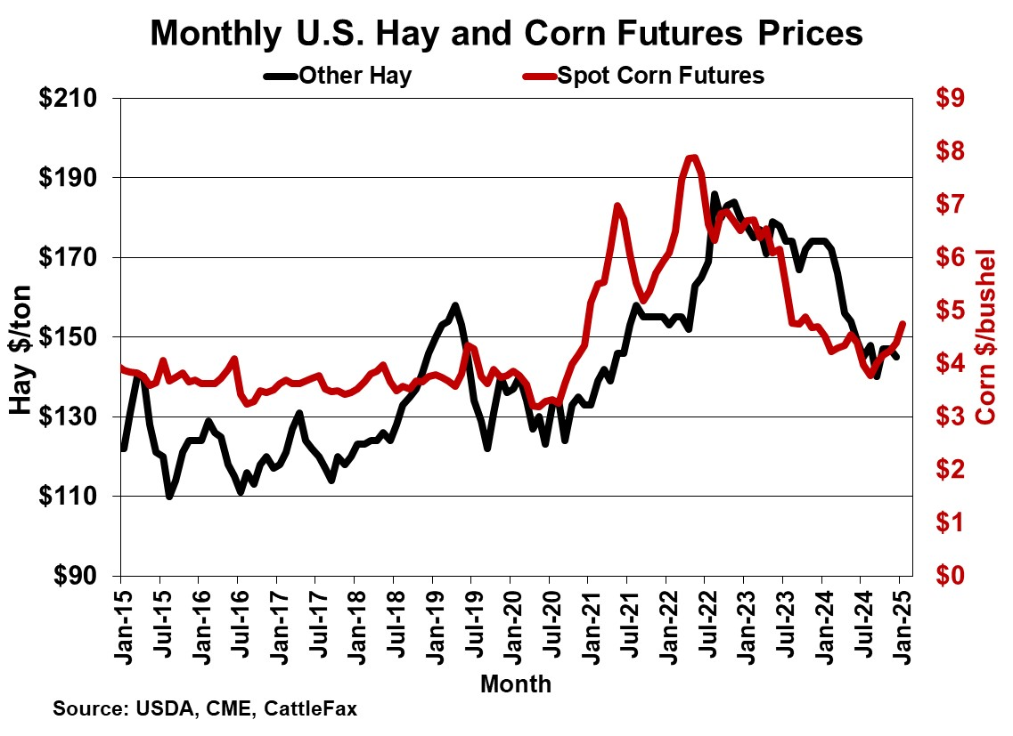

Slide 8
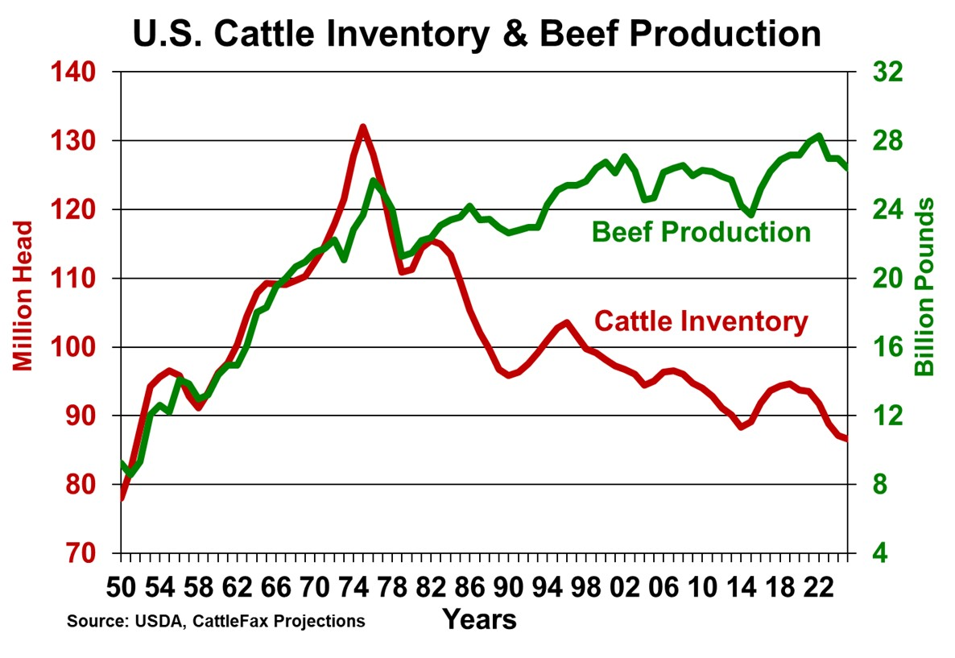
Notes:
74 x 85

Slide 9
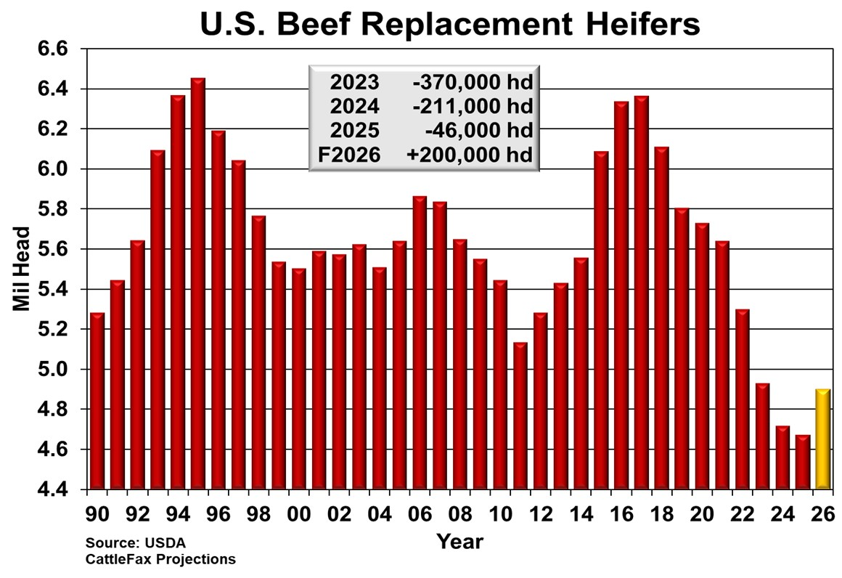

Slide 10
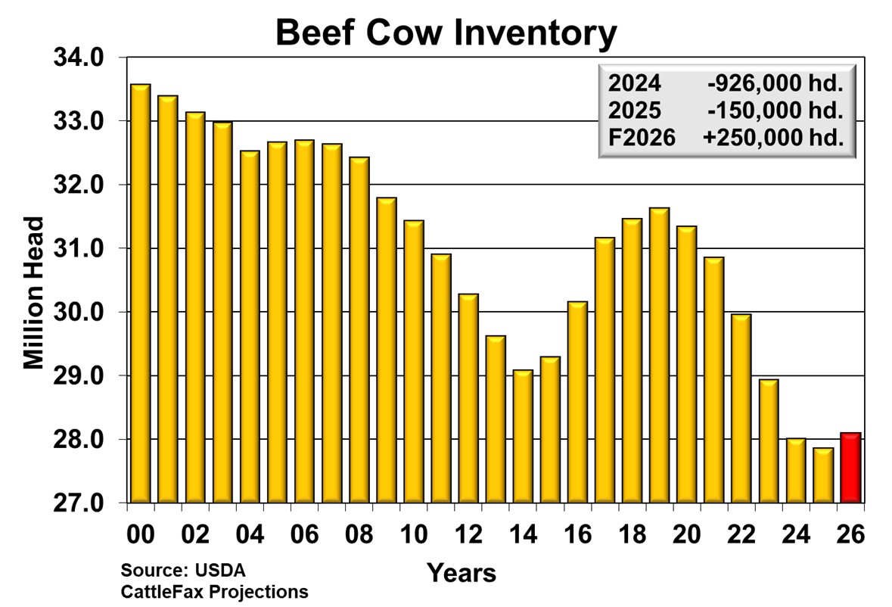

Slide 11
Headwinds to Beef Cow Herd Expansion
Long-term weather patterns
Age of producer
Labor availability and cost
Availability and cost of capital
Urban sprawl
Alternative land use

Slide 12
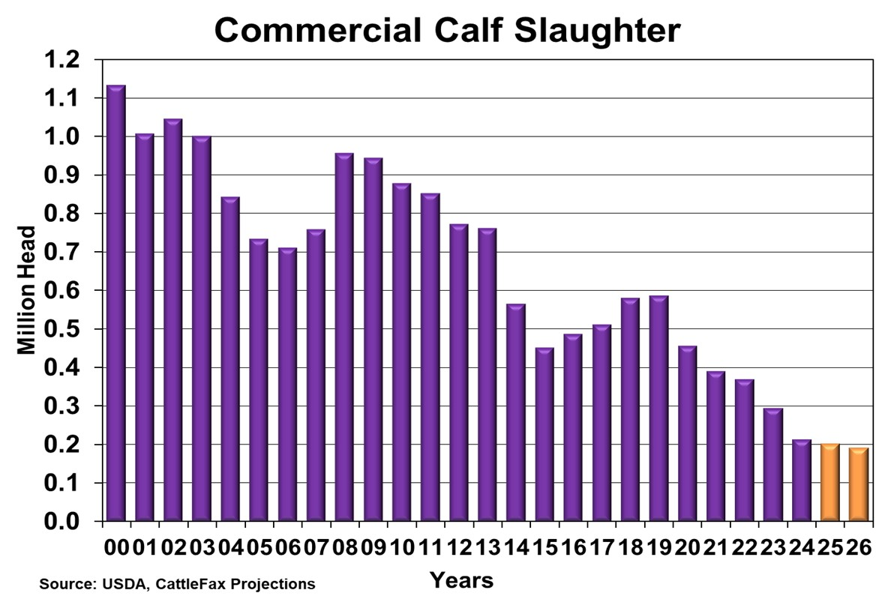

Slide 13
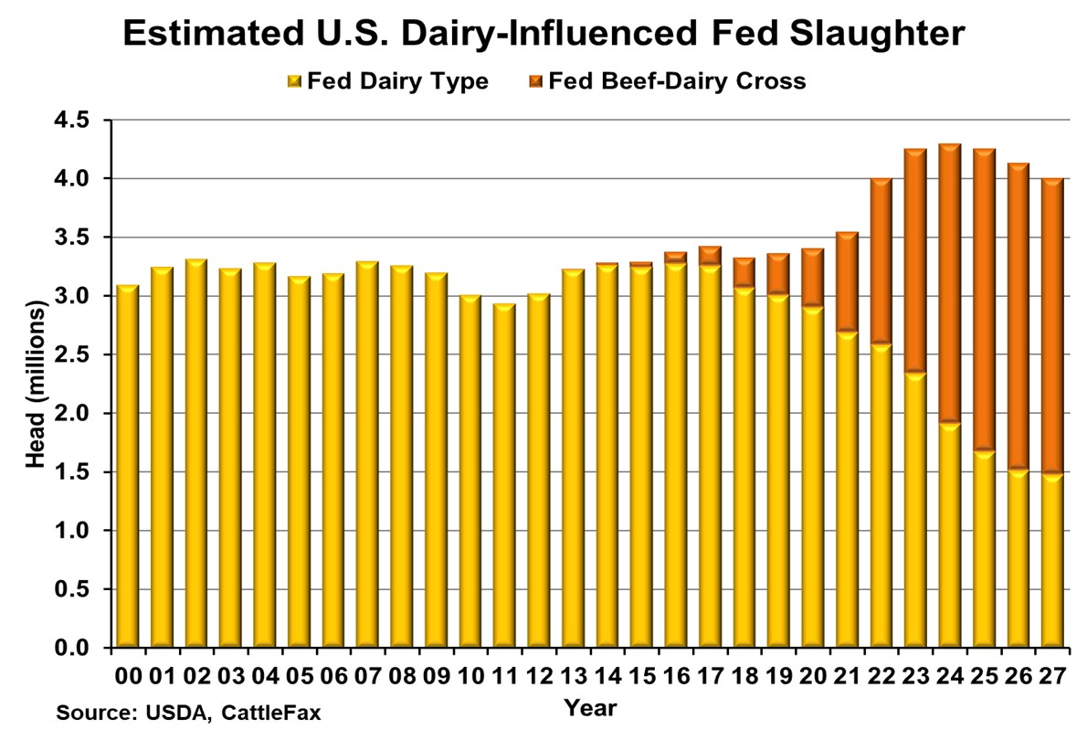

Slide 14
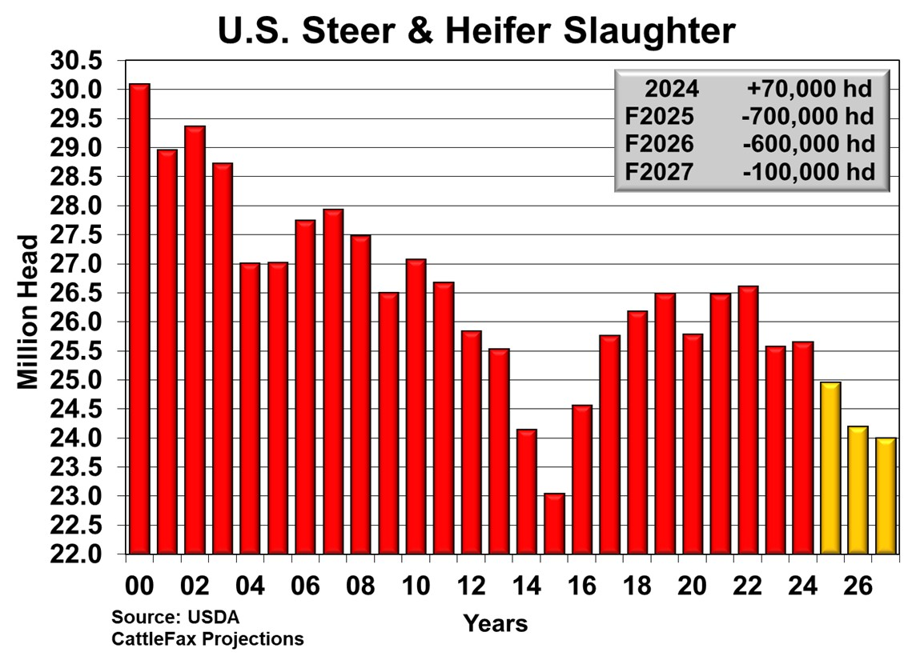

Slide 15
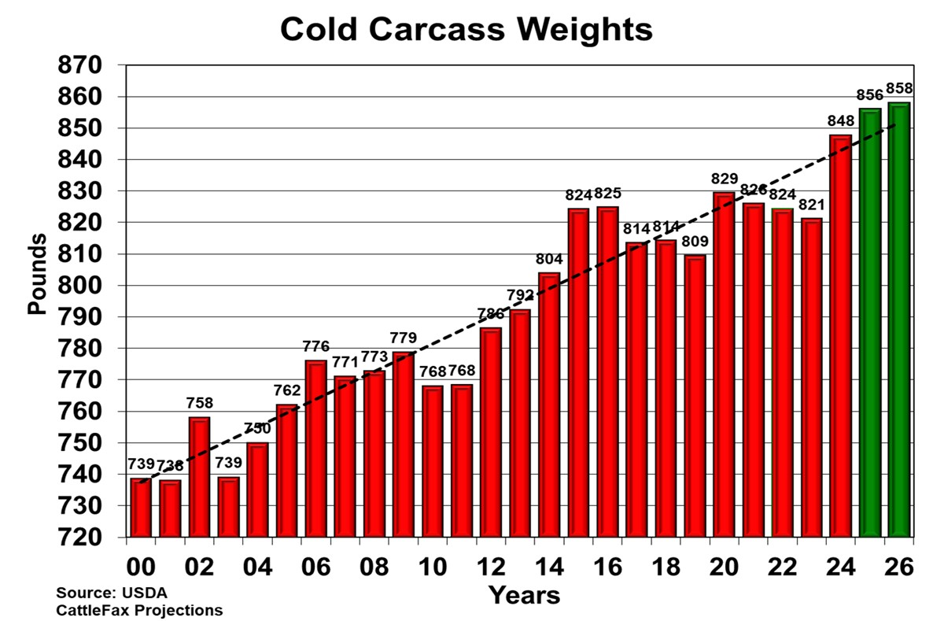

Slide 16
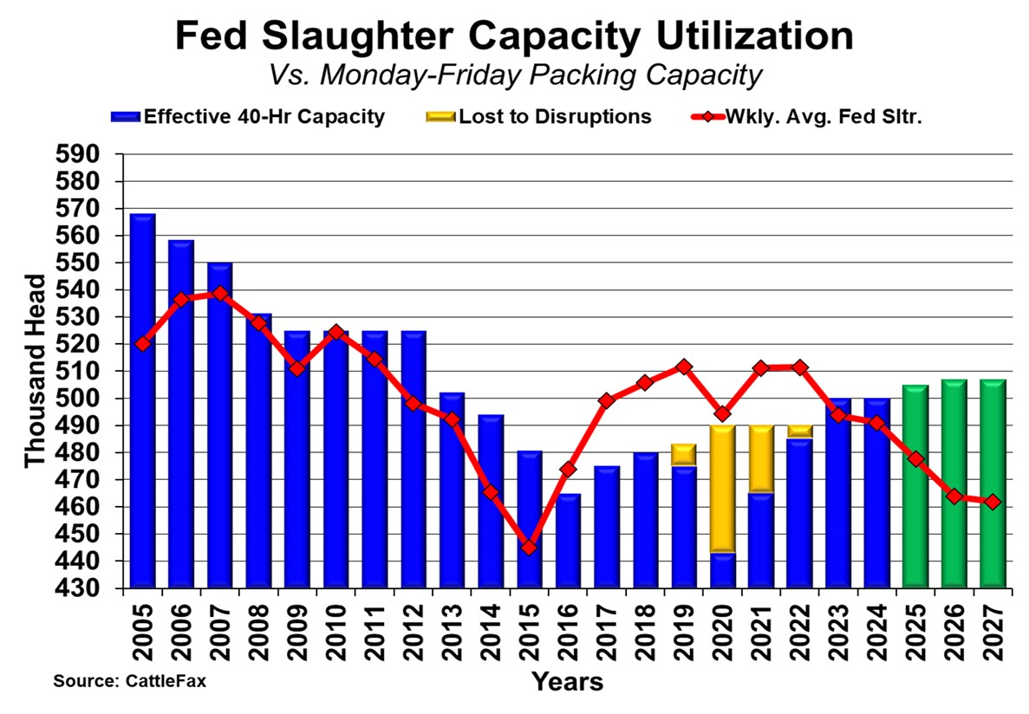

Slide 17
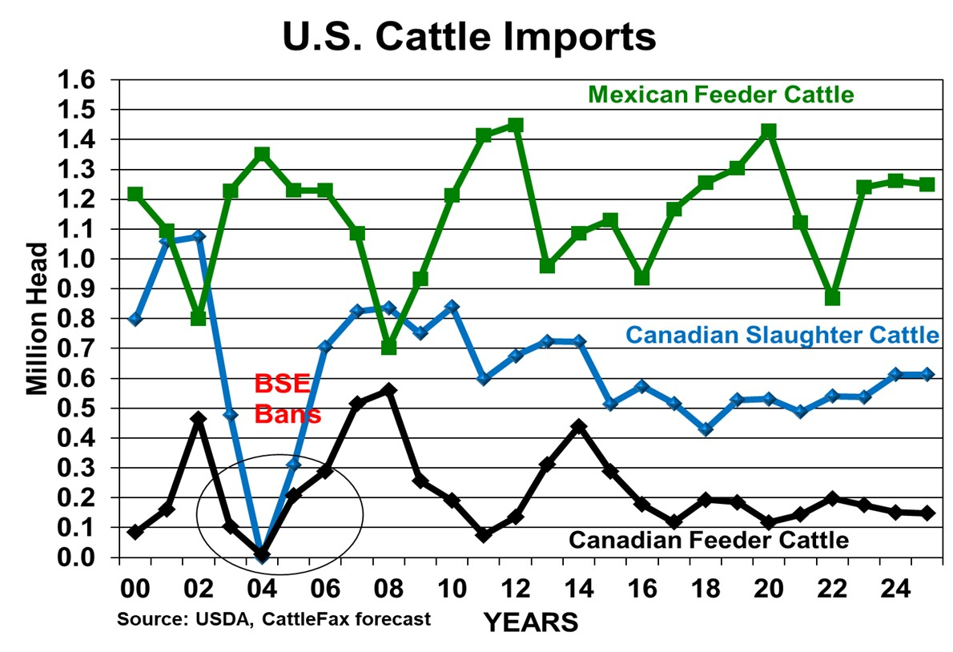

Slide 18
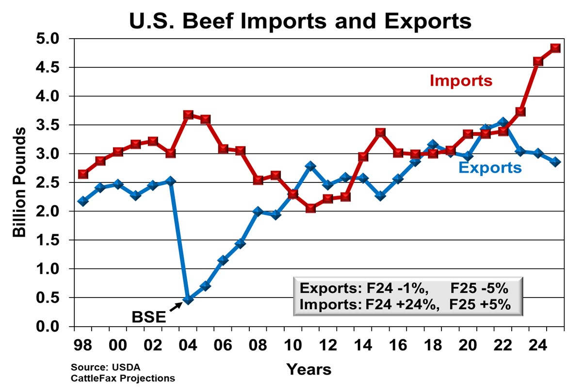

Slide 19
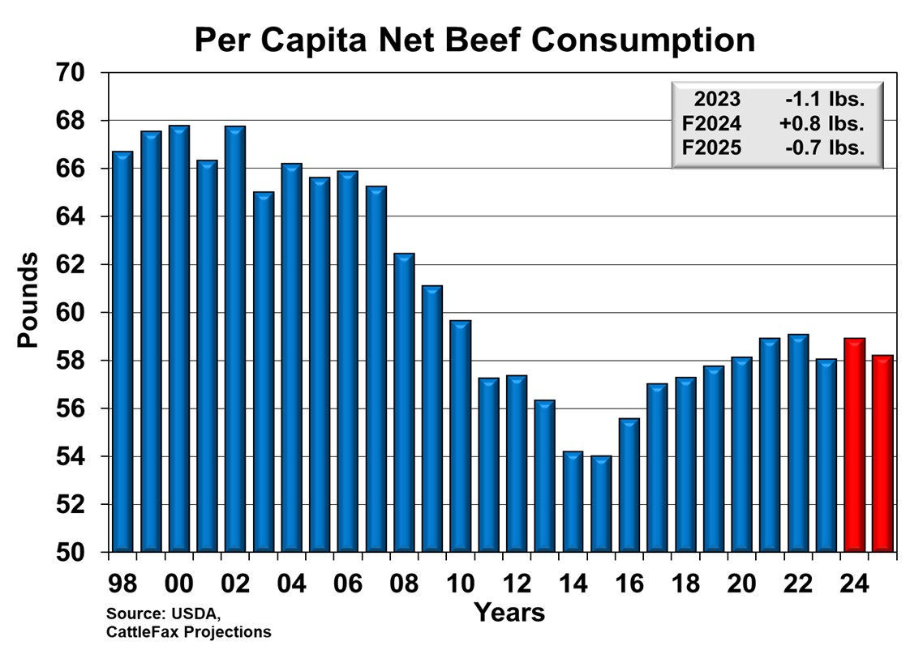

Slide 20
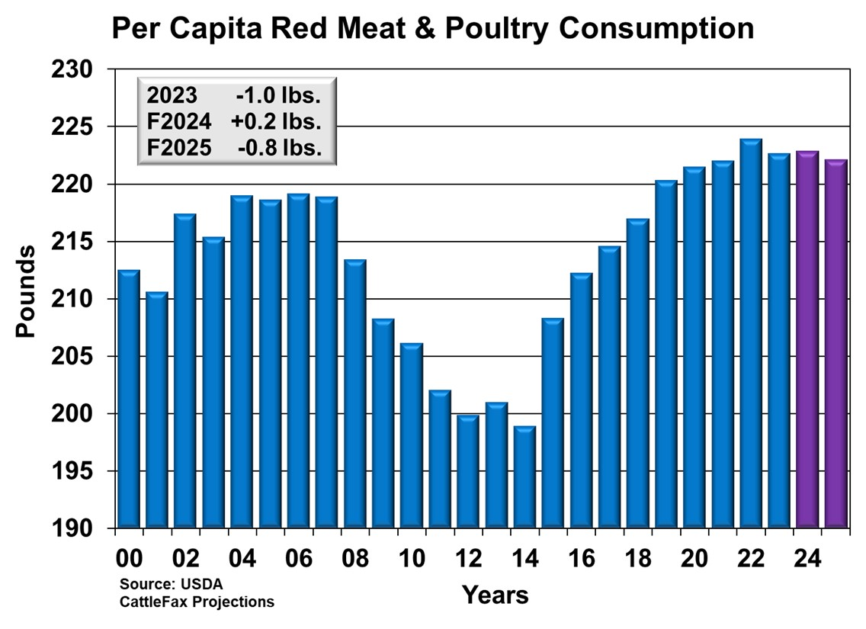
From 2012-2014
Beef +4 lbs.
Pork +4 lbs.
Chicken +18 lbs.
Turkey -2 lbs.

Slide 21
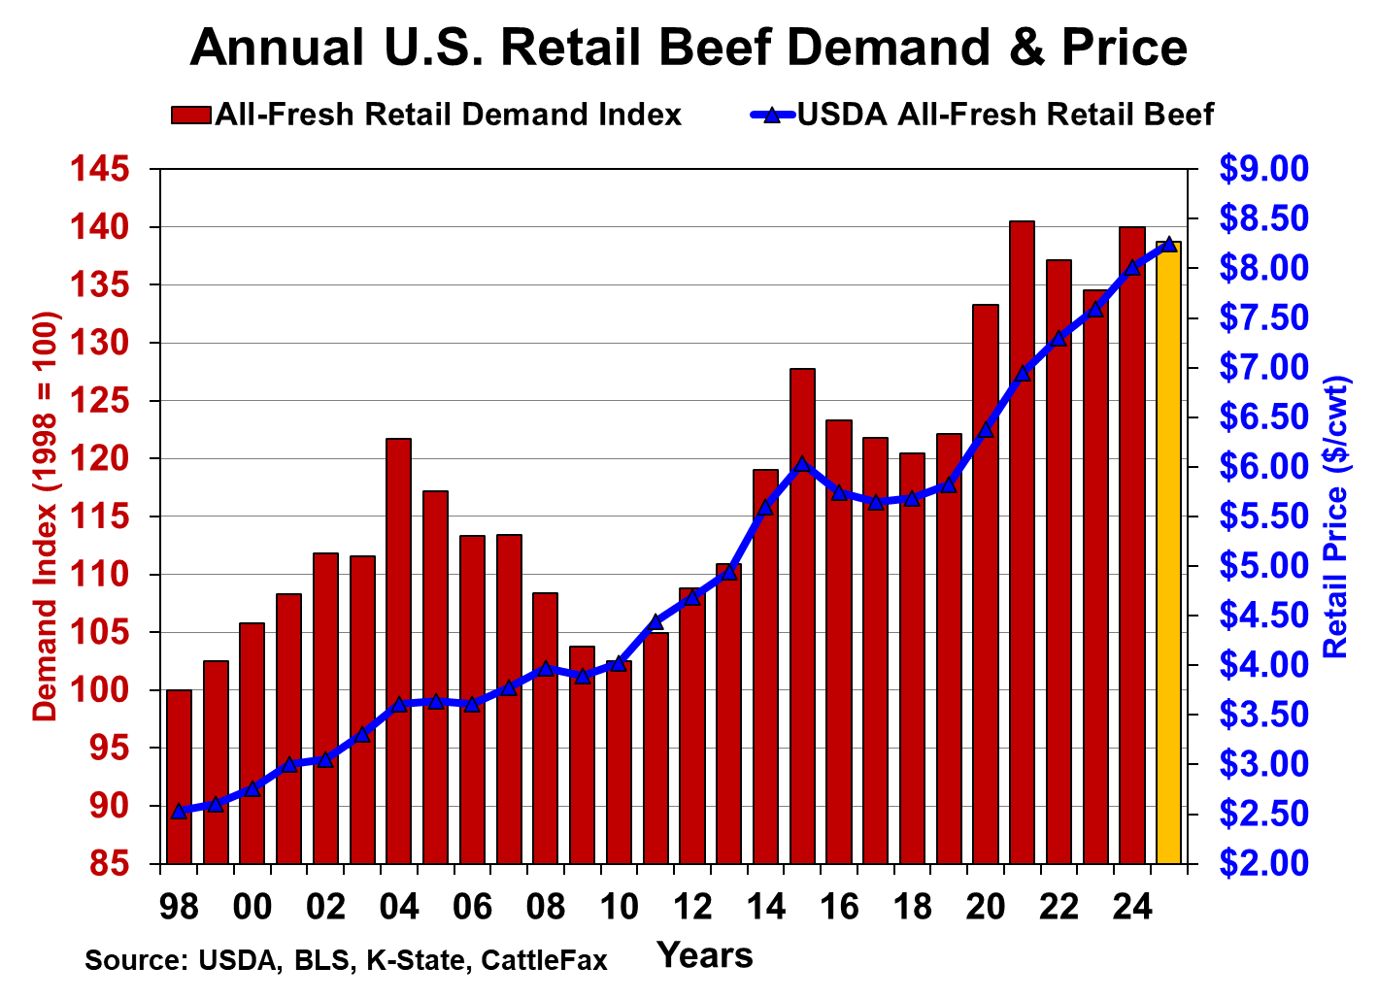
Beef prices will not go up as fast as the combination of inflation and declining supplies would suggest.
2020 +10%
2021 +9%
2022 +5%
+4%
+5%
F +3%
2000-2019 +4.5%/year average

Slide 22
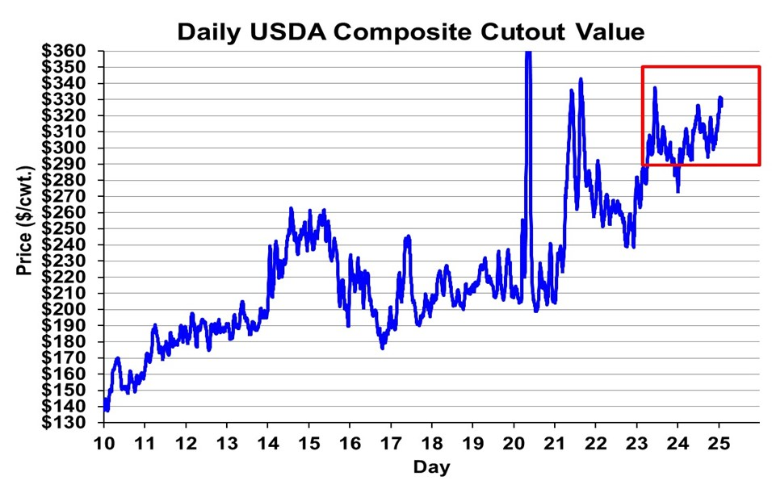

Slide 23
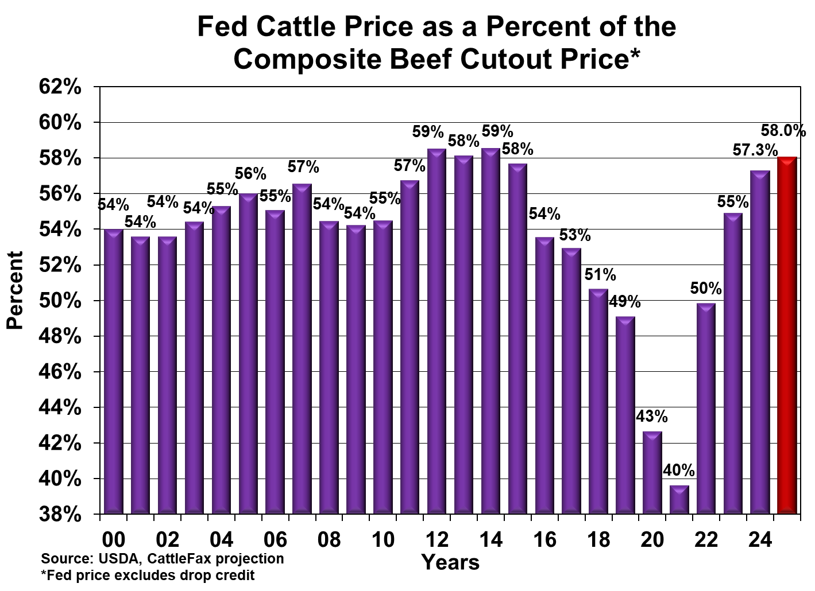

Slide 24
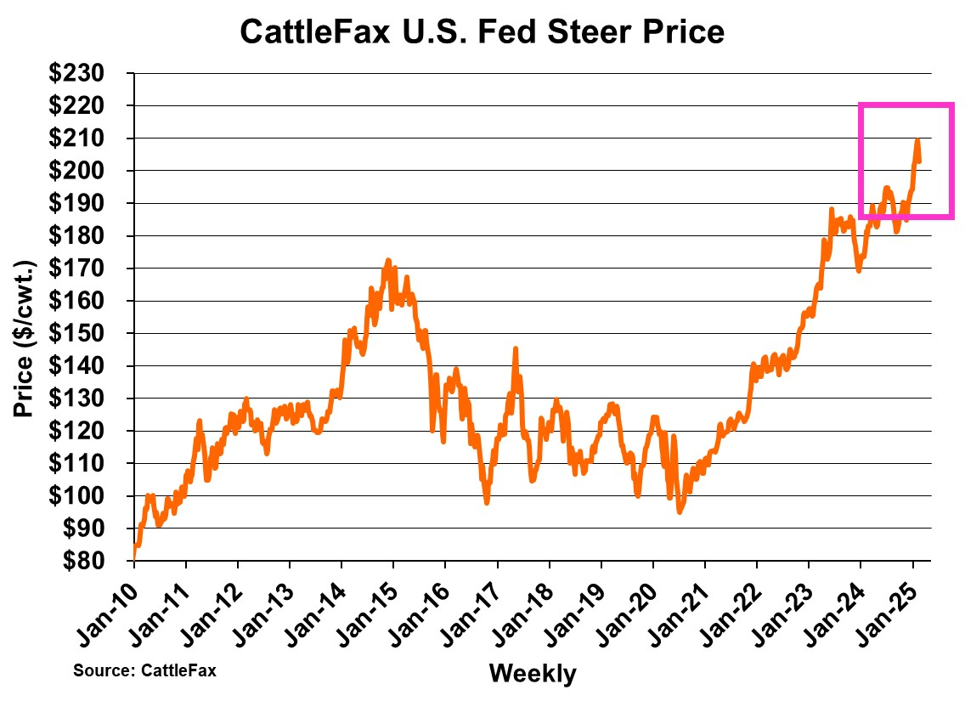

Slide 25
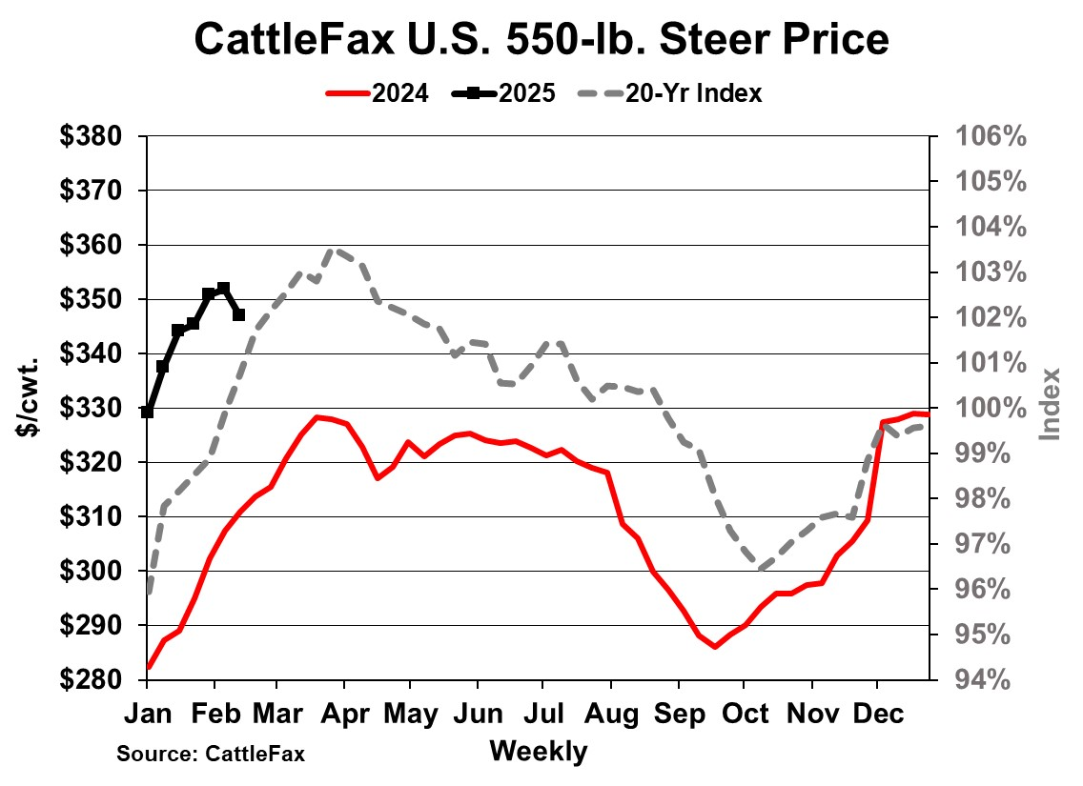

Slide 26
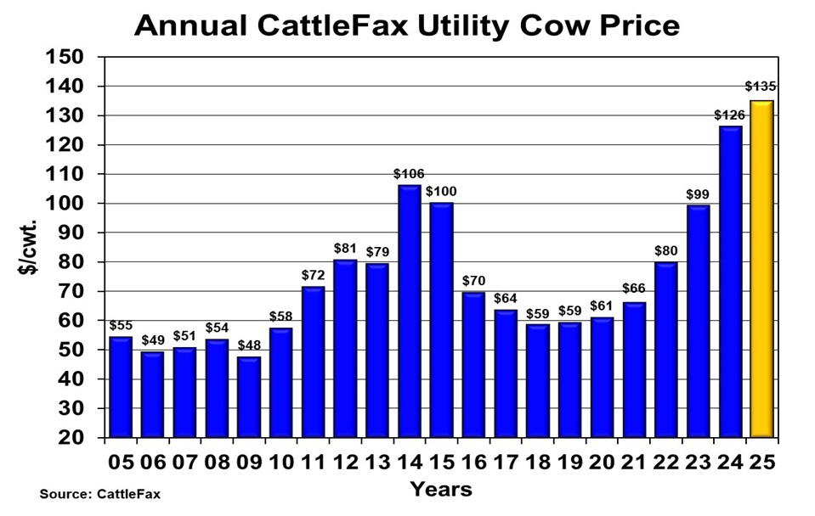

Slide 27
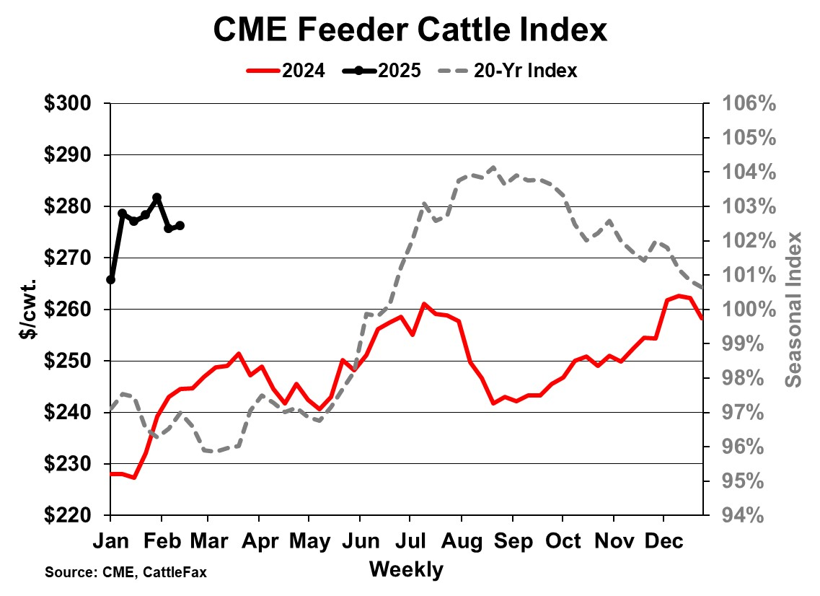

Slide 28
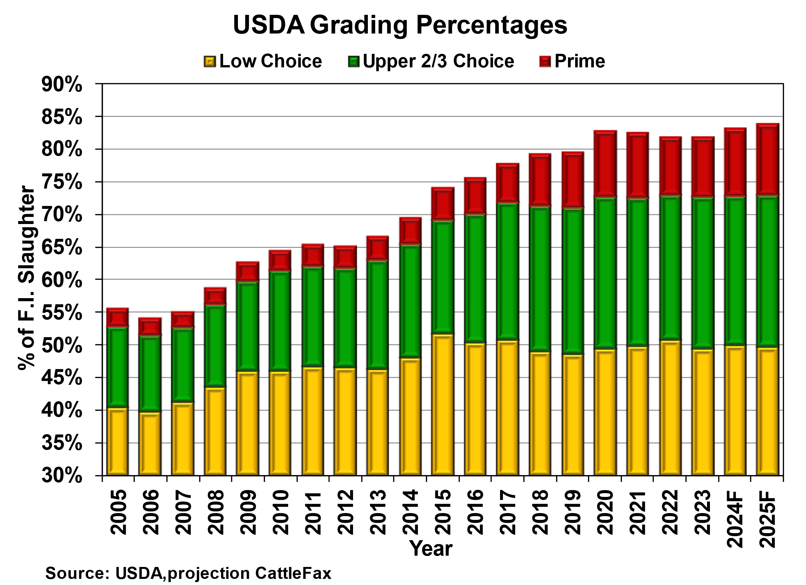
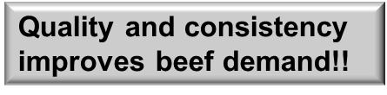
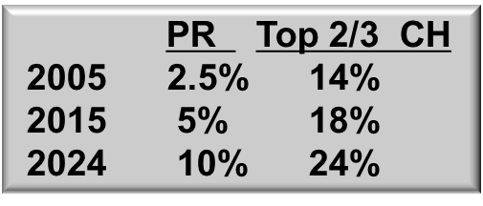
Notes:
https://cattlefax.sharepoint.com/sites/Cattle/Shared%20Documents/Grade,%20Weights,%20and%20Slaughter/Annual%20Data%20-%20CAB,%20QG,%20Prod,%20Cutouts.xlsx?web=1
Tab: PR+UpCh+LoCh %
Significant improvement in grading percentage of the last decade has driven demand growth with nearly 85% of cattle grading Choice or higher.
Prime grading percentage has quadrupled over the last 20 years.
Product quality is expected to remain historically strong in 2025 and provide a baseline of support to beef demand.

Slide 29
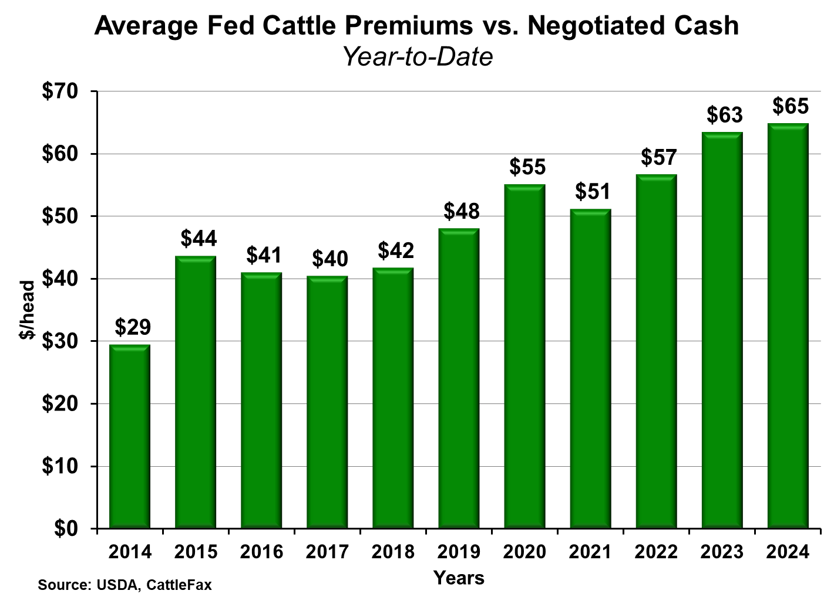

Slide 30
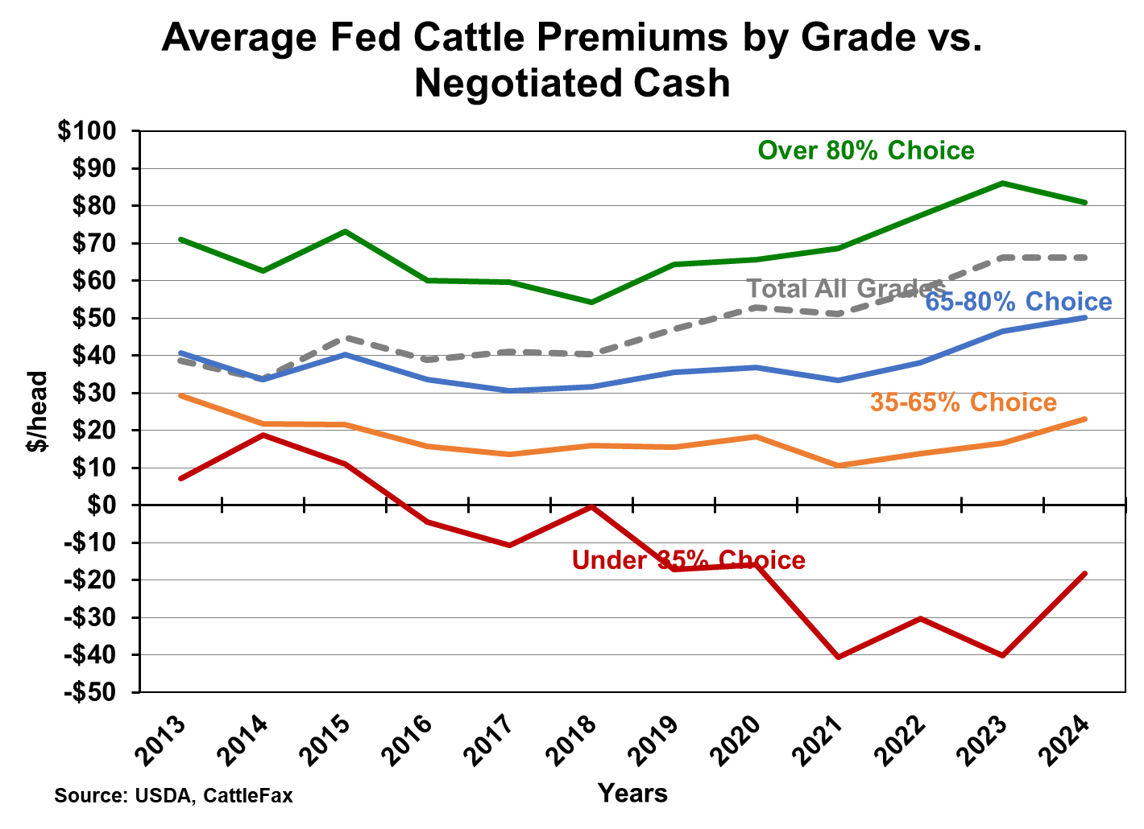

Slide 31
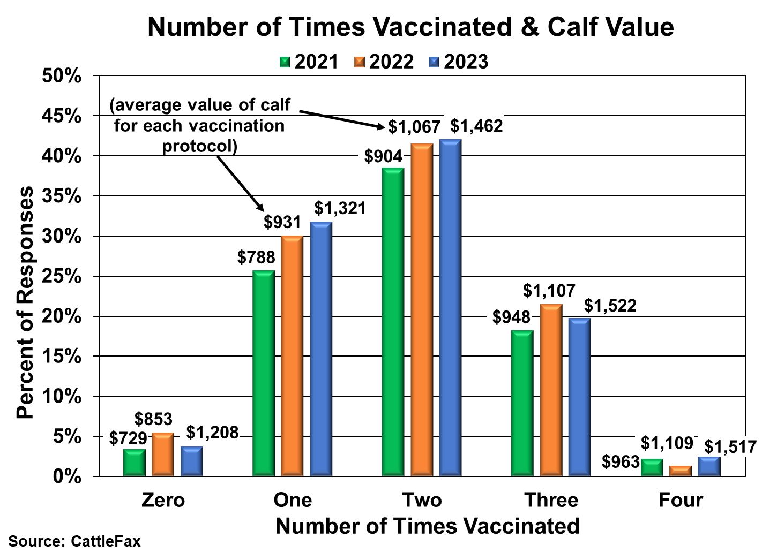

Slide 32
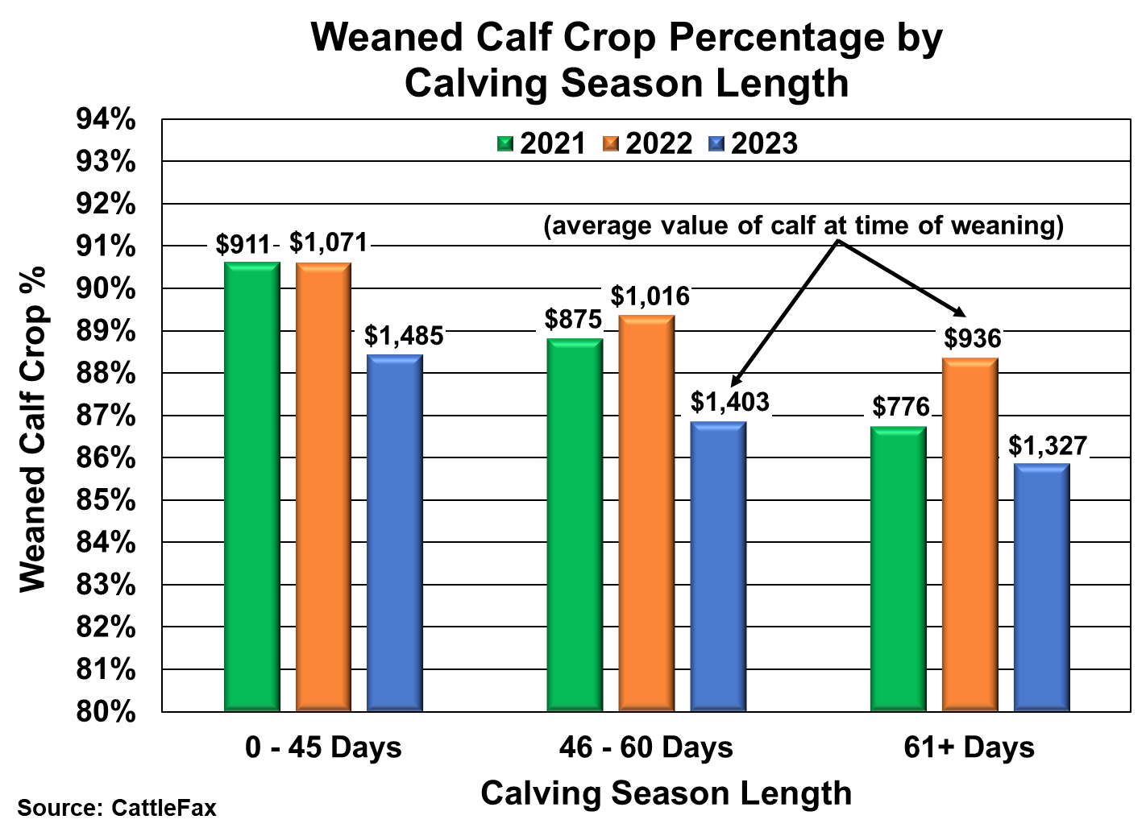
Notes:
New chart

Slide 33
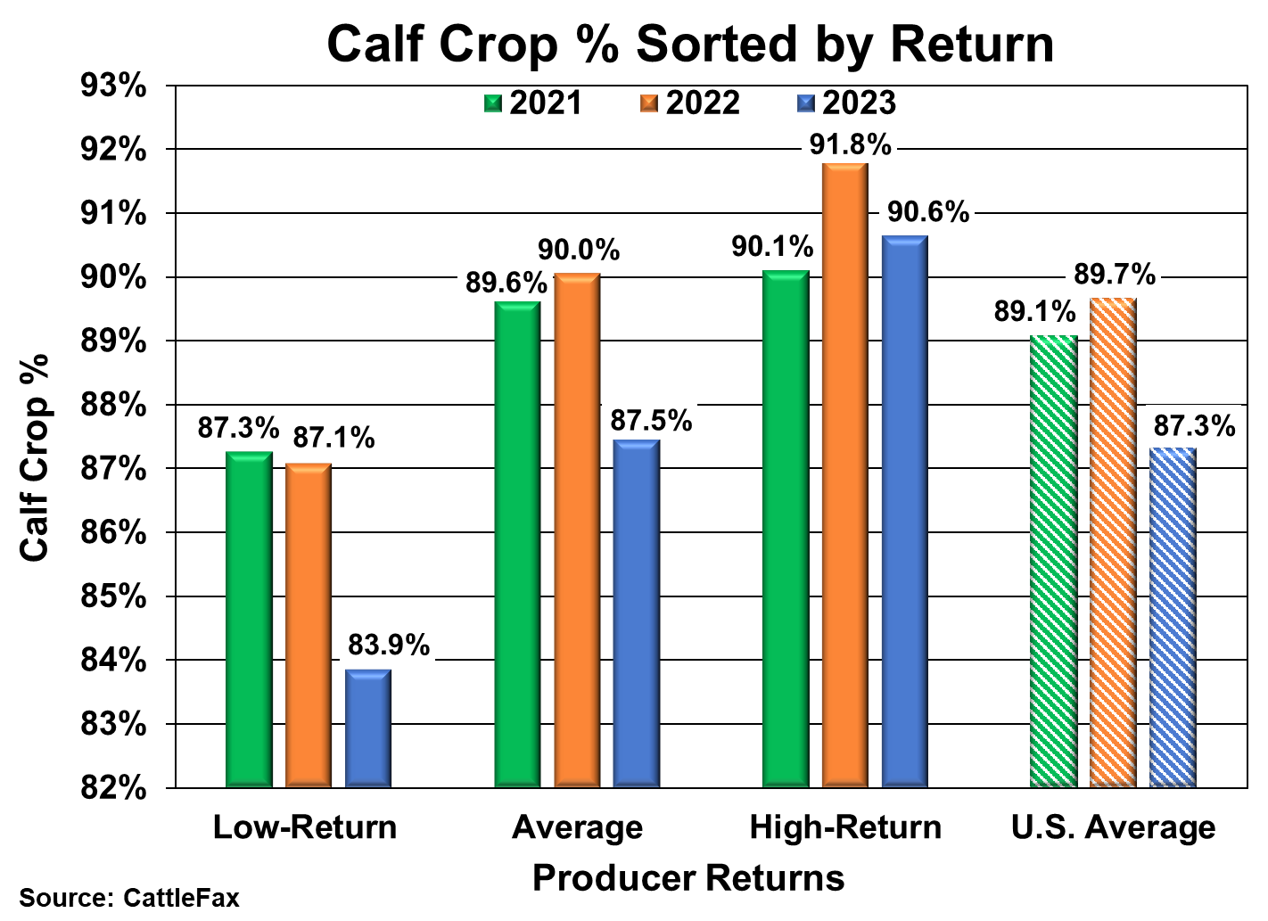

Slide 34
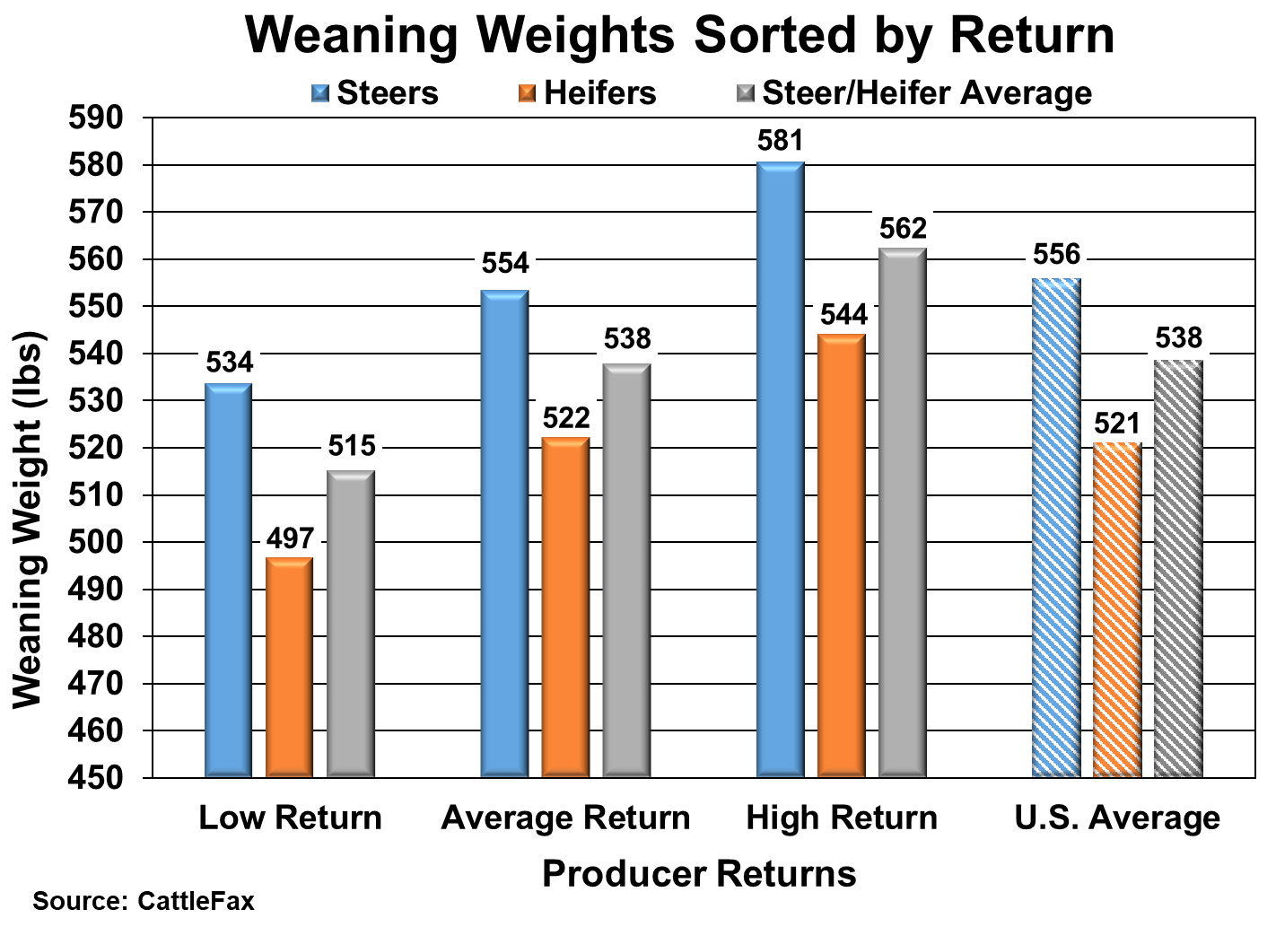

Slide 35
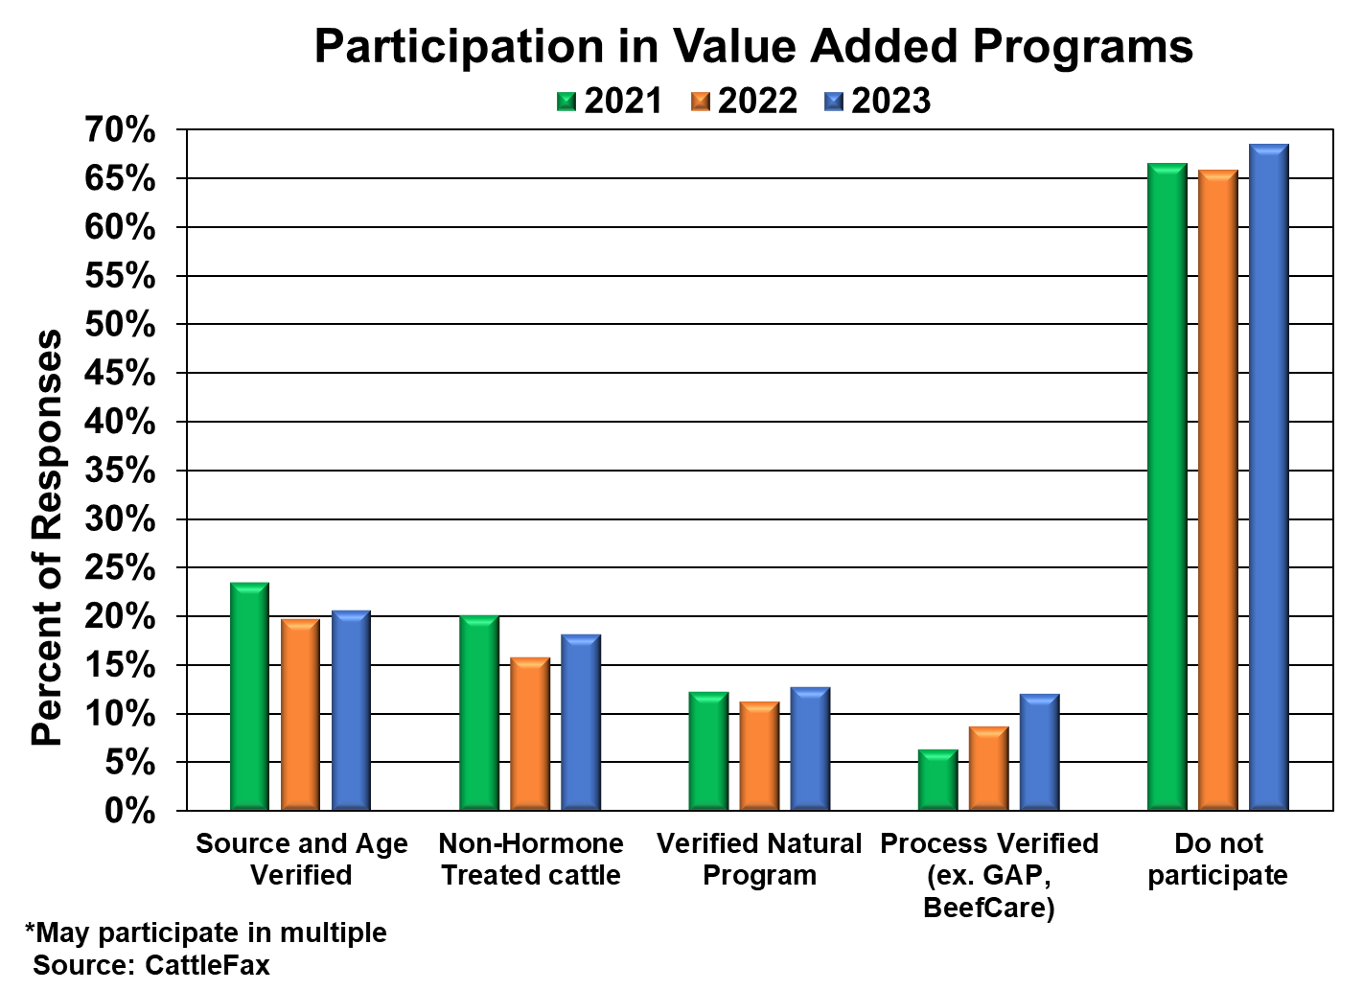

Slide 36
Thank You!
www.cattlefax.com
1.800.825.7525

