Slide 1
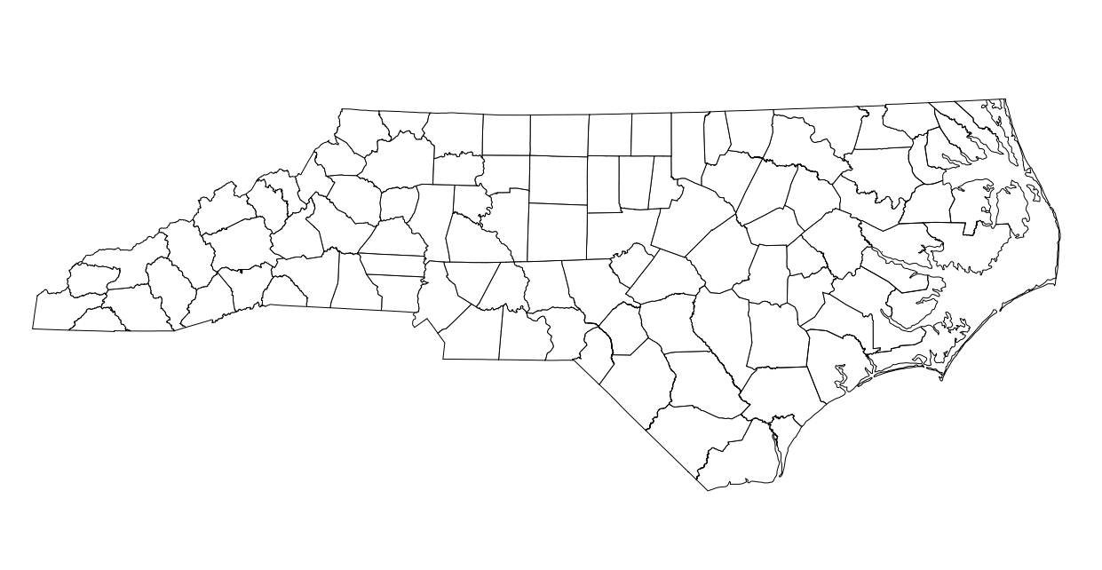

North Carolina Beef Cattle Worksheet
Name: ______________________ Date: ___________
1. List the Top Five Beef-Producing Counties in North Carolina and the number of cattle.
1) _________________________ __________ cattle
2) _________________________ __________ cattle
3) _________________________ __________ cattle
4) _________________________ __________ cattle
5) _________________________ __________ cattle
2. Shade the top five counties on your map.
3. Which region (Mountains, Piedmont, Coastal Plain) has the most cattle?
Answer: _____________________________
Color Map Activity:
Color the regions: Mountains (green), Piedmont (yellow), Coastal Plain (blue).

