Slide 1
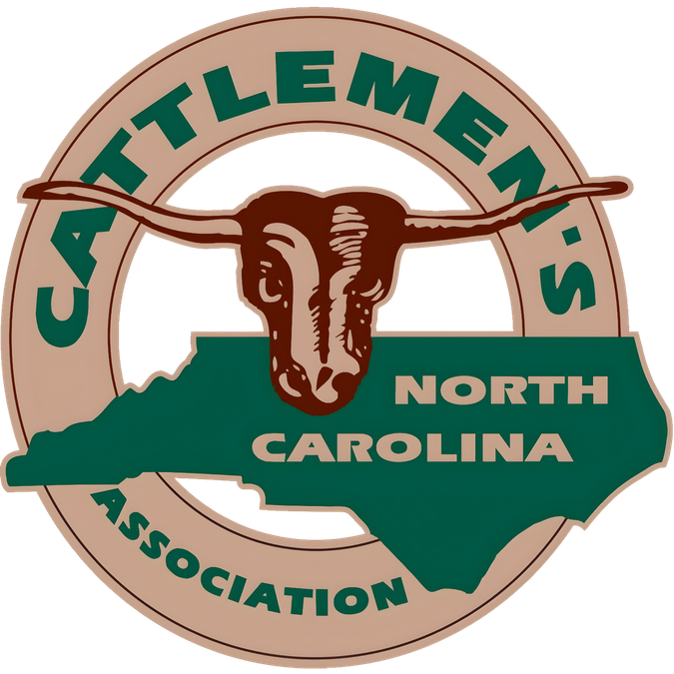

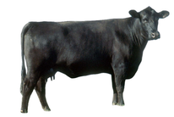
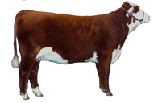
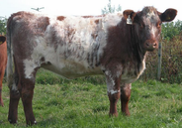
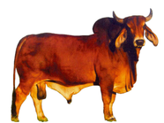
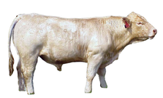
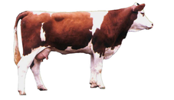
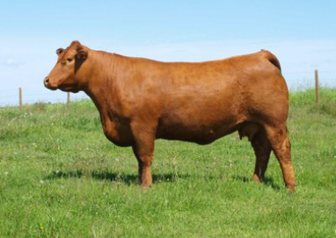
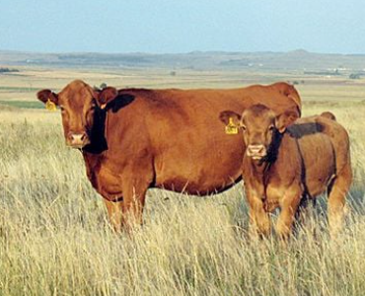
CATTLE BREEDS
A Guide to Popular Cattle Breeds
Angus
Hereford
Shorthorn
Origin: Scotland
Origin: England
Origin: England
Known for marbled beef, hardiness, and easy calving. Black or red coat. Polled (hornless).
Distinctive red body with white face. Docile temperament. Excellent foraging ability and adaptability.
Speckled/roan coat pattern Medium-sized, well-proportioned body, short horns (or polled varieties) .
Brahman
Charolais
Simmental
Origin: India
Origin: France
Origin: Switzerland
Heat and insect tolerant with distinctive hump. Loose skin aids cooling. Popular in tropical climates.
Large, muscular white breed. Rapid growth rate and lean meat. Often used in crossbreeding programs.
Large frame, horned or polled, and long and deep bodied. Yellowish brown to dark red with white markings.
Limousin
Gelbvieh
Origin: France
Origin: Southern Germany
Light golden/red color, muscular build, lighter circles around eyes. Great work animals in addition to their beef qualities.
Light golden/reddish-brown color, medium to large frame, smooth hair coat. Has superior fertility, calving ease, and growth rate of the calves.
QUICK FACTS
- There are over 1,000 recognized cattle breeds worldwide.
- Cattle were first domesticated approximately 10,000 years ago.
- Breeds are generally classified as beef, dairy, or dual-purpose.
- Crossbreeding combines desirable traits from multiple breeds.

