Slide 1

























Cattle Breed Matching
Match each cattle breed name to its key identification features. Drag and Drop the correct breed description beside the cattle breed.
Solid black body, no horns, smooth uniform build (Angus)
Speckled/roan coat pattern, medium-sized body, short horns (Shorthorn)
ANGUS
HEREFORD
White face, red body, white underside, and legs (Hereford)
Light golden/reddish-brown color, medium to large frame, smooth hair coat (Gelbvieh)
CHAROLAIS
BRAHMAN
Light cream/white coat, very large muscular body, broad chest (Charolais)
SIMMENTAL
Large hump on shoulders, droopy ears, loose skin (Brahman)
LIMOUSIN
SHORTHORN
White face, large robust frame, spotted or patchy coloring (Simmental)
GELBVIEH
Light golden/red color, muscular build, lighter circles around eyes

Slide 2
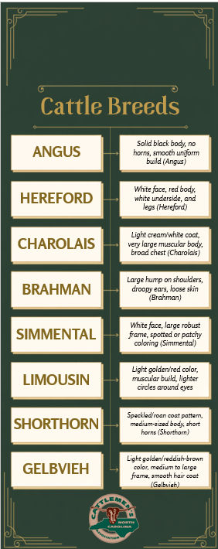
Resources:
https://afs.mgcafe.uky.edu/extension/4-h-youth/livestock/beef-discovery/breeds
Answer Key

