Slide 1

Cattle Breed Matching
Instructions:
Print out slide 2 in color. Cut each square to create 16 individual squares.
Create one set per small group (2-4 students).
Allow students to match the cattle breed to photo.
Extension
K-2 Cattle Breed Information
https://afs.mgcafe.uky.edu/extension/4-h-youth/livestock/beef-discovery/breeds
3-5 Cattle Breed Knowledge
https://agclassroom.org/matrix/lessons/284/
6-8 Cattle Breed Knowledge
https://breeds.okstate.edu/cattle
https://www.teachkyag.org/lessons/build-a-calf
9-12 Cattle Breed Knowledge
https://breeds.okstate.edu/cattle

Slide 2
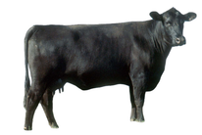
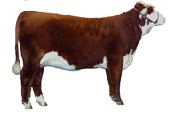
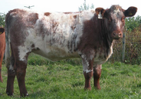
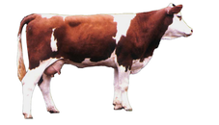
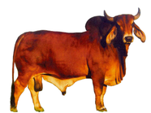
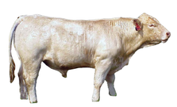
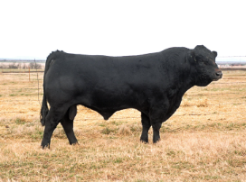
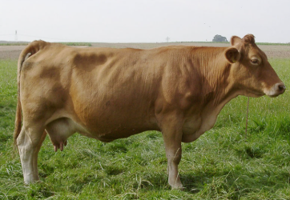
ANGUS | HEREFORD | CHAROLAIS | SIMMENTAL
BRAHMAN | LIMOUSIN | GELBVIEH | SHORTHORN

