Slide 1
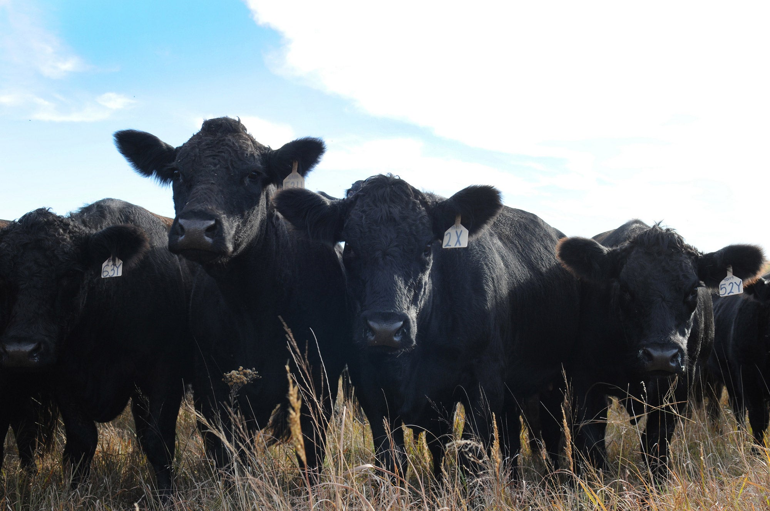
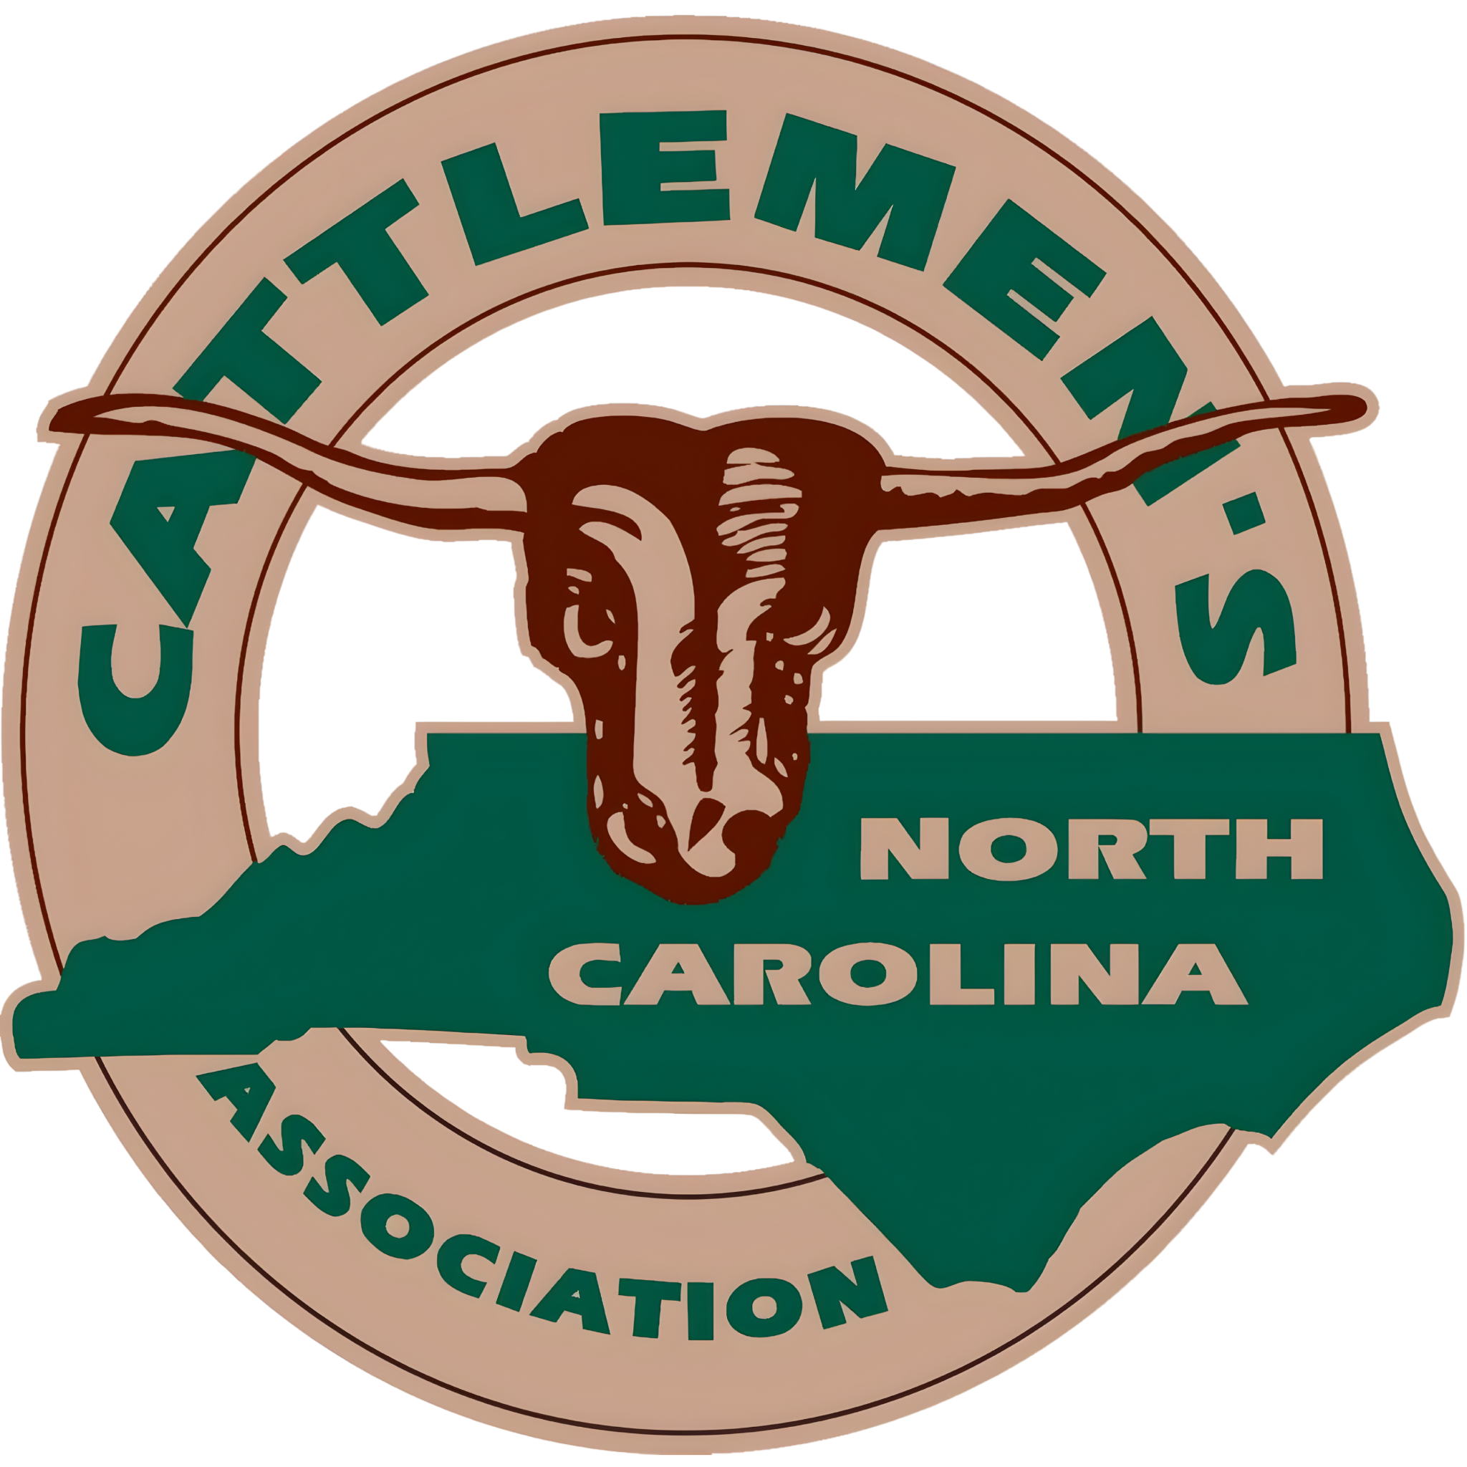
CATTLE BREED PROFILES: ORIGINS, TRAITS & IDENTIFICATION

Slide 2
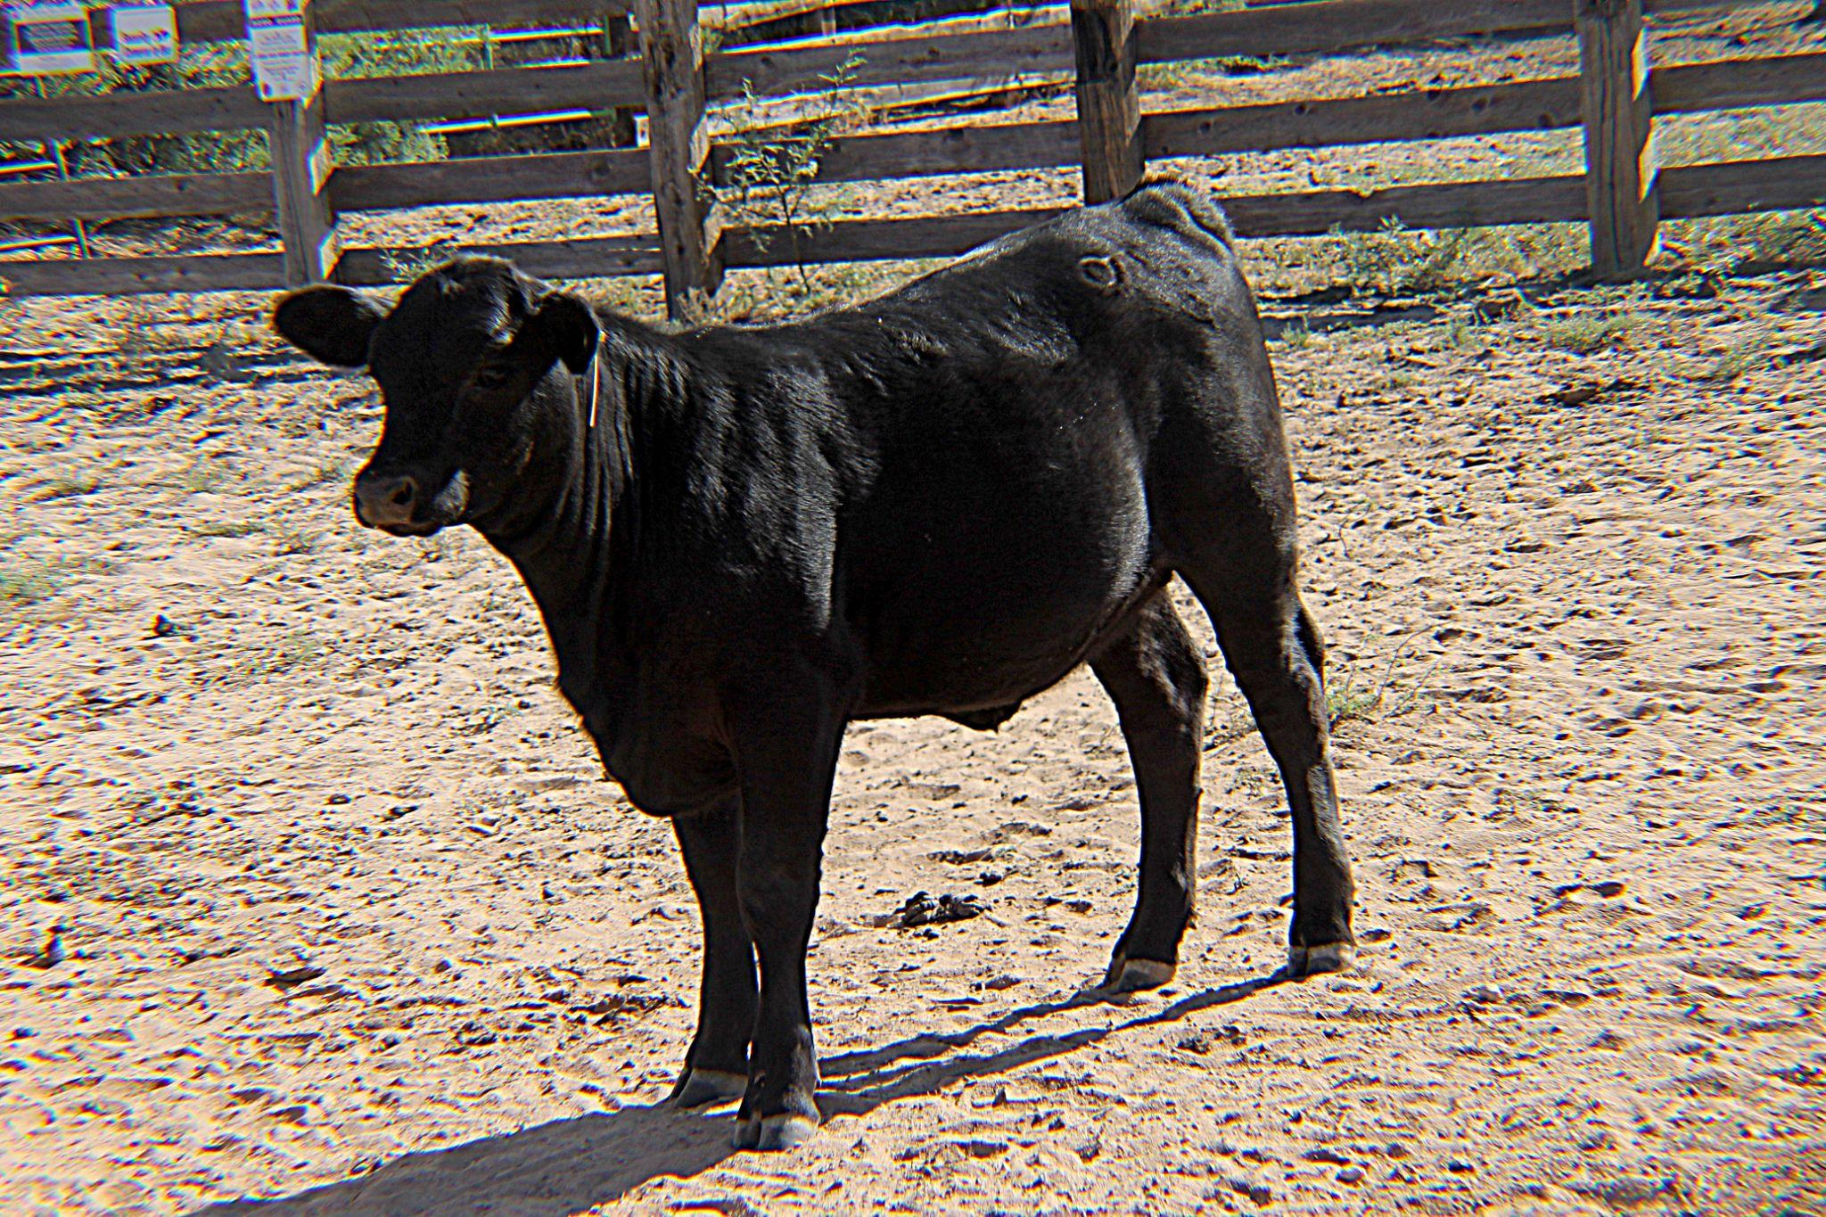
Cattle Breed Profiles
ANGUS
Origin
Aberdeenshire and Angus counties, Scotland. Avg Weight: Cows 1,150-1,250 lbs, Bulls 1,800-2,200 lbs. Trivia: The modern American Angus dynasty began in 1873 when George Grant brought four black Angus bulls to Victoria, Kansas, causing a stir at a livestock exposition dominated by horned breeds.
Key Traits
Known for high-quality marbling, producing tender and flavorful beef. Naturally polled (no horns). Highly adaptable to many climates.
Color
Identification
Solid black (or red). The black coloring is the most recognizable feature of this breed, giving them a sleek, uniform appearance.
Solid black body
No horns
Smooth, uniform build

Slide 3
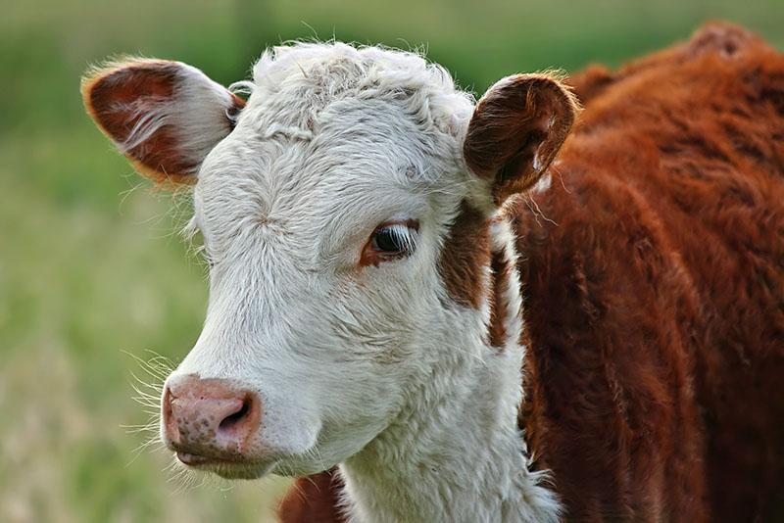
Cattle Breed Profiles
HEREFORD
Origin
Herefordshire, England, dating back to the mid-18th century. Avg Weight: Cows 1,200-1,400 lbs, Bulls 2,000-2,200 lbs. Trivia: Originally bred to produce efficient beef during the British Industrial Revolution. Henry Clay imported the first Herefords to the U.S. in 1817. The Polled variant was engineered in America in 1901 by Iowa breeder Warren Gammon.
Key Traits
Very hardy and adaptable to diverse climates. Known for calm, docile temperament making them easy to handle. Efficient grazers that thrive on pasture.
Coloring
Identification
Distinctive red body with white face. White markings extend to underside and legs, creating their signature appearance.
White face
Red body
White underside and legs

Slide 4
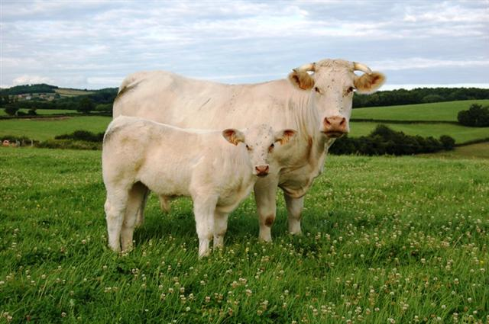
Cattle Breed Profiles
CHAROLAIS
Origin
The Charolles region of France. Avg Weight: Cows 1,250-1,600 lbs, Bulls 2,000-2,500 lbs. Trivia: French law protected Charolais genetics for centuries, strictly prohibiting crossbreeding. They didn't arrive in North America until after WWI, when Mexican general Lazaro Cardenas imported a small selection to his private ranch in 1930.
Key Traits
Large frame and fast growth rate. Produces lean, muscular meat with heavy muscling. White or cream colored coat makes them easily recognizable.
Frequently used as terminal sires in crossbreeding programs to improve carcass size, muscling, and lean meat yield in offspring.
Identification
Light cream/white coat
Very large, muscular body
Broad chest and hindquarters

Slide 5
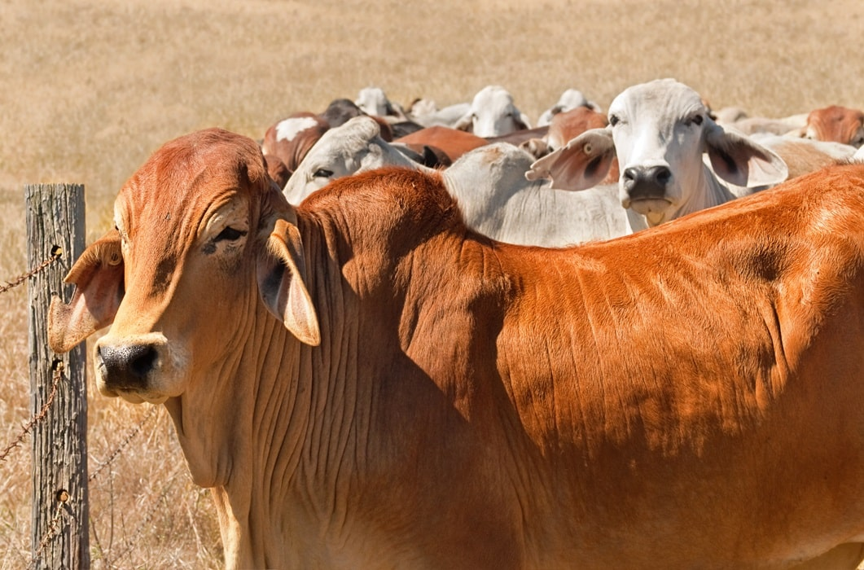
Cattle Breed Profiles
BRAHMAN
Origin
India. Ideal for hot, humid climates; common in southern U.S. Trivia: For hundreds of years, Wagyu and other Asian cattle like Brahman were used as draft animals. Brahman cattle are frequently crossbred to improve heat tolerance and durability in other breeds.
Key Traits
• Extremely heat and insect resistant
• Distinct hump and loose skin
• Strong disease resistance
Characteristics
Gray to red coloring. Known for exceptional adaptability to tropical and subtropical environments. Their loose, thick skin helps regulate body temperature.
Identification
Large hump on shoulders
Droopy ears
Loose skin

Slide 6
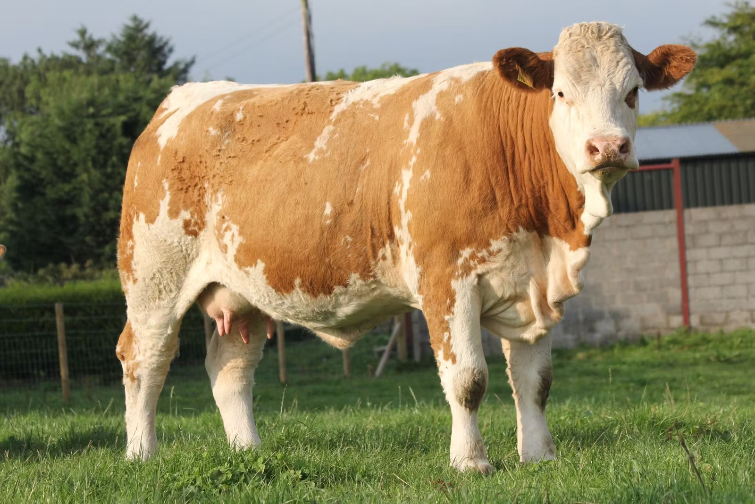
Cattle Breed Profiles
SIMMENTAL
Origin
The Simme Valley in western Switzerland. Avg Weight: Cows 1,300-1,500 lbs, Bulls 2,200-2,500 lbs. Trivia: While Simmentals are exclusively beef cattle in the U.S., they are a dual-purpose milk and meat breed across Europe. Swiss monks were selectively breeding these red-and-white cattle as early as the 1400s.
Key Traits
Fast growth and large size. Good milk production alongside beef qualities. Strong maternal ability makes them profitable for producers.
Color
Red, gold, or tan body with distinctive white markings. The combination of colors creates their characteristic spotted or patchy appearance.
Identification
White face is a key identifier
Large, robust frame
Spotted or patchy coloring pattern

Slide 7
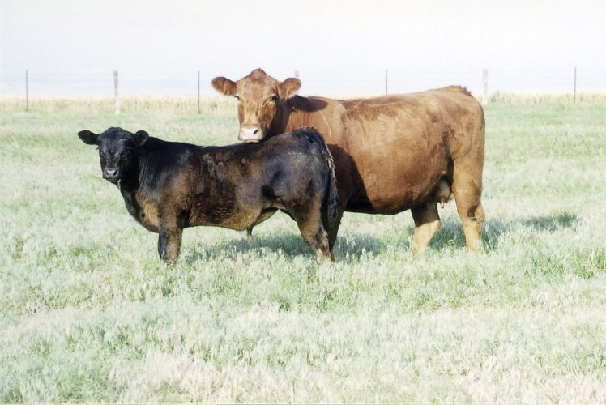
Cattle Breed Profiles
LIMOUSIN
Origin
The Limousin/Marche regions of France. Avg Weight: Cows 1,200-1,350 lbs, Bulls 2,000-2,400 lbs. Trivia: Limousin cattle are immortalized in the ancient 20,000-year-old French cave paintings found in Lascaux, matching the structural profile of today's live animals.
Key Traits
Lean, muscular carcasses with high meat yield. Efficient feed conversion makes them economical for producers. Golden-red coloring is distinctive.
Color
Golden-red coat color throughout the body. Known for their attractive, uniform coloring that makes them easily recognizable in the field.
Identification
Light golden/red color
Muscular build
Lighter circles around eyes

Slide 8
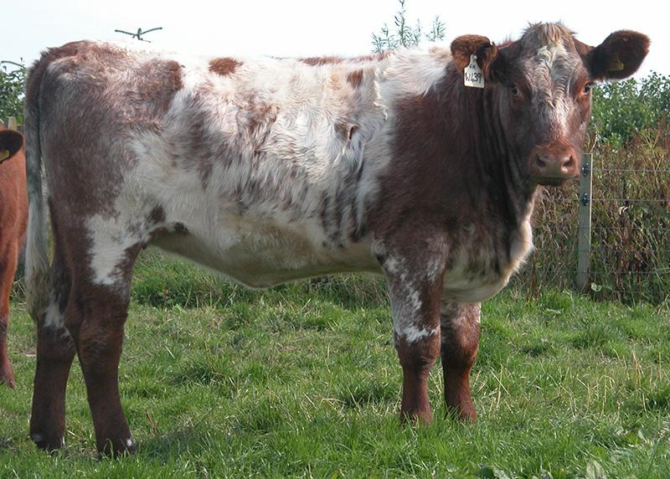
Cattle Breed Profiles
SHORTHORN
Origin
Tees River Valley, northeastern coast of England. Avg Weight: Cows 1,300-1,500 lbs, Bulls 2,000-2,200 lbs. Trivia: Shorthorn cattle pulled the covered wagons of western settlers before serving as their primary source of milk and meat. They hold the distinction of having the very first official breed registry and herd book established for any animal type in the world (1822).
Key Traits
Dual-purpose breed suitable for both beef and dairy production. Good milk production capabilities. Known for calm, docile temperament making them easy to handle.
Color
Identification
Red, white, or roan (speckled). The roan coloring is a distinctive mix of red and white hairs creating a unique speckled appearance.
Speckled/roan coat pattern
Medium-sized, well-proportioned body
Short horns (or polled varieties)

Slide 9
Cattle Breed Profiles Resources
https://breeds.okstate.edu/cattle
https://www.animalimagegallery.org/

